Slide 1





Evolutionary Algorithms for Primer Discovery
Alberto Tonda, UMR 518 MIA-Paris, Paris, France
E. Claassen, Vrije Universiteit Amsterdam, The Netherlands
J. Garrsen, A. D. Kraneveld, A. Lopez Rincon, Utrecht University, The Netherlands
E. Coz, P. Tabeling, J. Vanhomwegen, Institut Pasteur, Paris, France
L. Mendoza Maldonado, Hospital Civil de Guadalajara, Mexico
C. A. Perez Romero, UNICEQ, Santiago de Querétaro, Mexico
Notes:
Good afternoon, my name is Alberto Tonda and the title of our submission to HUMIES is “Evolutionary Algorithms for Primer Discovery”.

Slide 2
Primer discovery
Primers
  Short sequences of DNA/RNA (~21 base pairs, e.g. ACTGT...GCA)
  Characteristic of a specific virus (or variant)
  Frequent enough to be found in all samples of target virus...
  ...but specific enough to not be found in different strains
  This can be complex for variants
Application: tests for viruses (e.g. SARS-CoV-2 and variants)
Notes:
Test kits are based around primers, short sequences of RNA, that can vary between 18 and 26 base pairs. Primers should be characteristic of a specific virus or variant: in other words, these subsequences should appear in the genome of almost every sample of the target virus, and almost never appear in the genome of related variants or in other kinds of virus. This is a particular complex task for variants, as they differ from the original strain only by a few mutations.
There are also other requirements for good candidate primers: for example, their melting temperature should be in a specific range, to make them usable in real-world conditions; or there should be a presence of specific base pairs around the beginning or the end of the sequence, to facilitate the reactions in which they are going to be used.

Slide 3
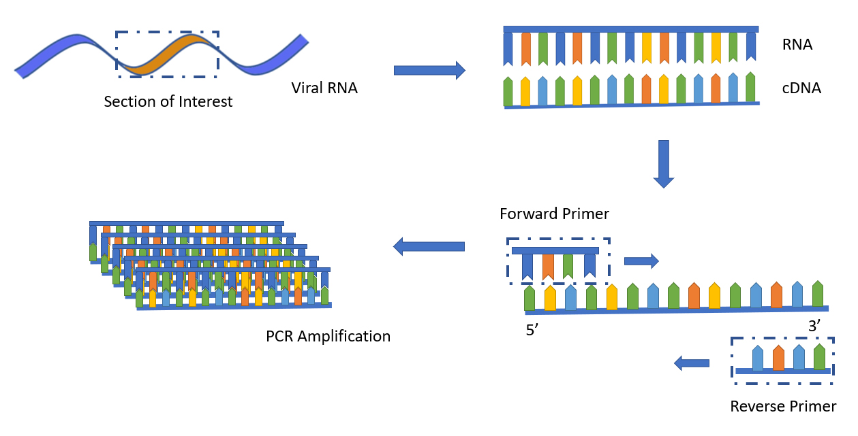
Primer discovery
Once a primer is identified, a qRT-PCR test can be devised
Notes:
Once a primer is identified, a procedure like quantitative real-time polymerase chain reaction can be used. The primer, here called forward primer, will attach to a part of the viral genome. A second sequence, called reverse primer, that can be straightforwardly computed from the first, will attach to another part of the viral genome. The sequence identified by the forward and reverse primer will then be amplified by the polymerase chain reaction, up to the point that it can be detected. If the primers do not attach, the reaction does not start and the test will be negative.

Slide 4
Traditional approaches
Once the canonical sequence is defined
  Manual inspection of the virus’ genome (~30k base pairs)
  Experts can find parts that uniquely identify it
  Issue: it takes time
Tests for variants are more complex
  Targeting multiple locations in the RNA at the same time
  Issue: require specific, more expensive equipment

Slide 5
Data availability
Global effort to share sequences of SARS-CoV-2 viral RNA
  GISAID (Global Initiative on Sharing Avian Influenza Data)
  NCBI (National Center for Biotechnology Information)
Samples of SARS-CoV-2 (or target variant)
Samples of other (similar) virus strains

Slide 6
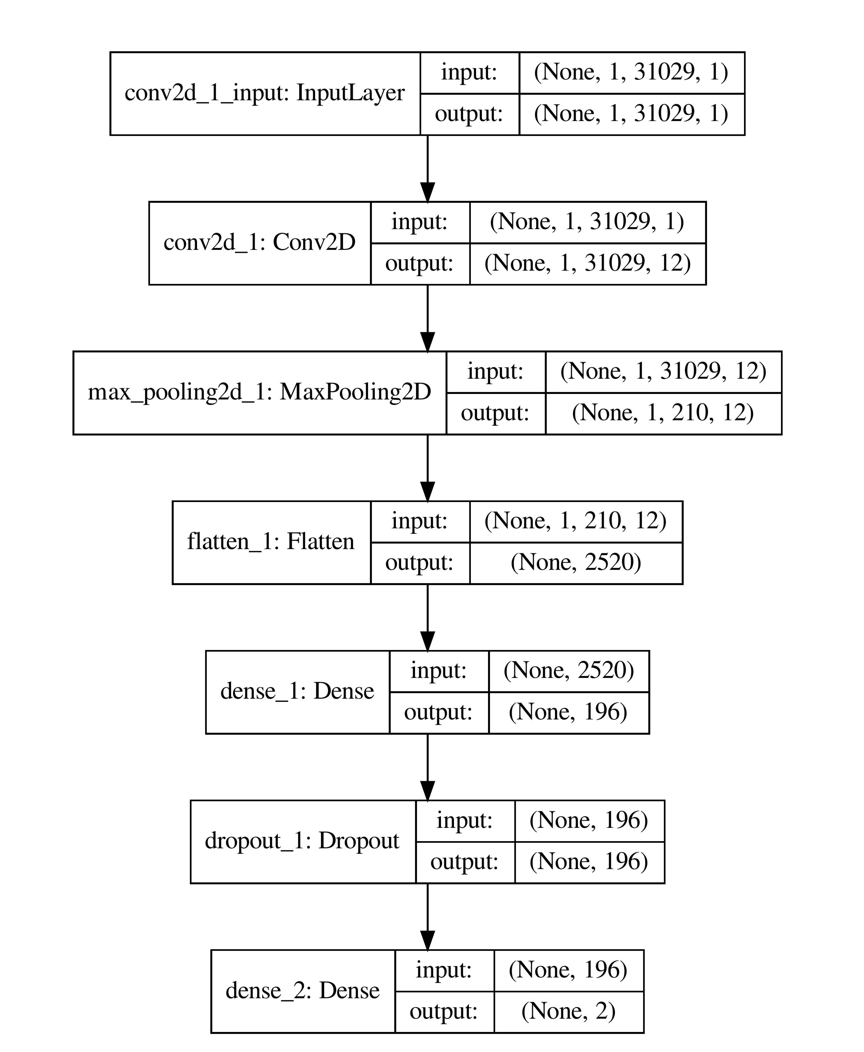
Novel approaches
Convolutional Neural Networks
  Train classifier, extract subsequences that identify target class
  Given enough virus samples, quite fast and effective
  Long post-processing to screen candidates
  Issue: hard to take into account requirements
Evolutionary Algorithms!

Slide 7
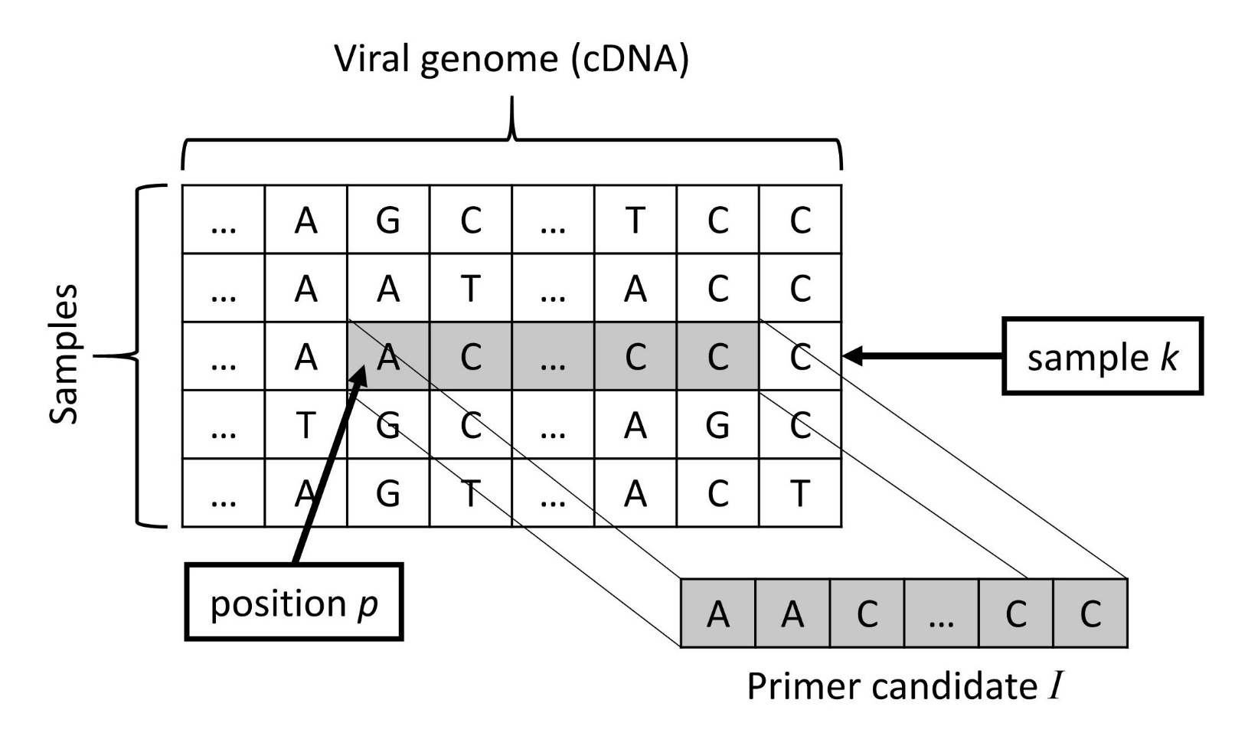
Genome of a candidate solution
Two integers, k and p, index a dataset of viral samples
Fixed length, 21 bps
Notes:
We are using a fixed length to compare our results against other techniques, that also produced primers of size 21.

Slide 8
Fitness function
Weighted sum of different factors
  Frequency of appearance in virus samples of target strain (max)
  Frequency of appearance in samples from other strains (min)
  Presence of ‘C’ and ‘G’ base pairs as close as possible to 50%
  Absence of ‘N’ symbols (read error)
  Melting temperature T_{m} as close as possible to 60°C
Notes:
We are also trying to keep the presence of ‘C’ and ‘G’ base pairs close to 50% of the candidate primer, that is important for the following reaction…
Melting temperature that is important for real-world usability of the candidate primer

Slide 9
Results
Primers for variants
  B.1.1.7 (Alpha), published in GECCO 2021
  B.1.1.529 (Omicron), published on Biorxiv
  Original SARS-CoV-2, published on Biorxiv
Primers tested in lab
  Against other single-target primers
  Proved able to successfully react to target variant, only

Slide 10
Results

Slide 11
Results

Slide 12
HUMIES criteria
B (The result is equal to or better than a result that was accepted as a new scientific result at the time when it was published in a peer-reviewed scientific journal.)
The primers discovered thanks to the evolutionary approach are competitive with results obtained by both humans (World Health Organization) and deep neural networks; in particular, they provide equal or better specificity, while preserving all other favorable qualities (melting temperature in a given range, presence of specific base pairs, etc.)

Slide 13
HUMIES criteria
E (The result is equal to or better than the most recent human-created solution to a long-standing problem for which there has been a succession of increasingly better human-created solutions.)
Primers obtained through the evolutionary approach are competitive with human-devised primers, and they have been obtained in the span of just a few days.

Slide 14
HUMIES criteria
F (The result is equal to or better than a result that was considered an achievement in its field at the time it was first discovered.)
Due to the urgency of tackling the pandemic, the relatively timely development of human-devised primers to correctly identify SARS-CoV-2 and its variants was considered an achievement.

Slide 15

Conclusions
Primer discovery using Evolutionary Algorithms
  Can be developed faster than with traditional human expertise
  Are cheaper than multi-target approaches
  Can fit more complex criteria than with Deep Neural Networks

Slide 16
Future developments
Primers for monkeypox
  Search space is larger (30k base pairs vs 200k)
  Already developed in-silico, waiting to be tested in lab
Predictors of anti-biotic resistance in bacteria
  Emerging issue, leading cause of death in hospitals
  Find subsequences of DNA that confer resistance to anti-biotics
  Search space is considerably larger (30k base pairs vs >1M)

Slide 17


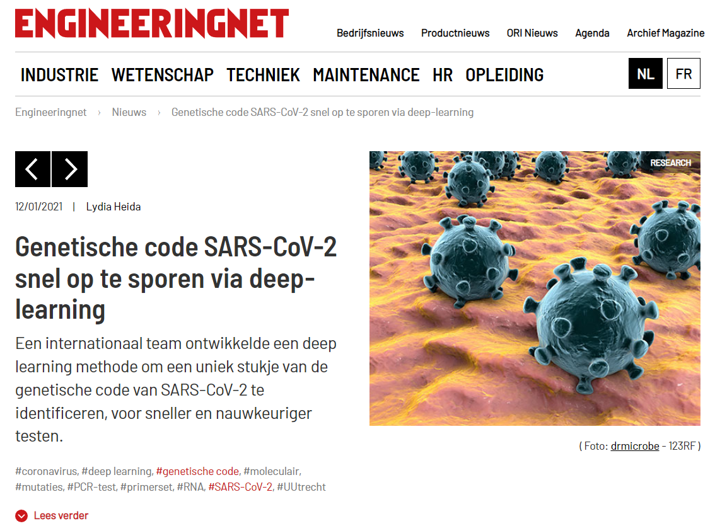





Our research in the media

Slide 18
Thank you for your time!
A. Lopez Rincon, C. A. Perez Romero, L. Mendoza Maldonado, E. Claassen, J. Garssen, A. D. Kraneveld, and A. Tonda. 2021. Design of specific primer sets for SARS-CoV-2 variants using evolutionary algorithms. In Proceedings of the Genetic and Evolutionary Computation Conference (GECCO '21). Association for Computing Machinery, New York, NY, USA, 982–990. https://doi.org/10.1145/3449639.3459359
C. A. Perez Romero, A. Tonda, L. Mendoza Maldonado, E. Coz, P. Tabeling, J. Vanhomwegen, E. Claassen, J. Garssen, A. D. Kraneveld, A. Lopez Rincon. 2021. Design of Specific Primer Sets for the Detection of SARS-CoV-2 Variants of Concern B.1.1.7, B.1.351, P.1, B.1.617.2 using Artificial Intelligence, bioRxiv 2021.01.20.427043; https://doi.org/10.1101/2021.01.20.427043 (submitted to PNAS)

