Slide 1
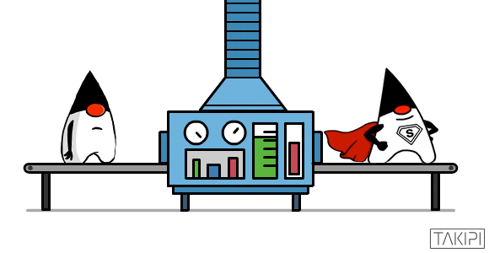



Darwinian Data Structure Selection
ARTEMIS
Michail Basios
Lingbo Li
Fan Wu
Leslie Kanthan
Earl T. Barr
Notes:
I bet that you have picked default data structures without thinking potential optimizations that alternative implementations or configurations can offer.
We use defaults to retain focus and avoid useless optimisations, sometimes making a note to go back which we rarely do. This is especially true with data structures as they provide easy to use interfaces hiding the internals to the user.
And most of the attention is on the algorithm implementation and the logic of the program.

Slide 2
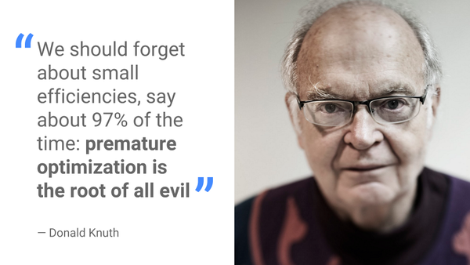
Donald Knuth’s Advice
Darwinian Data Structure Selection Speaker: Michail Basios
Notes:
Developers are following one part of Knuth’s advice: they are avoiding premature optimisation. Indeed, developers appear to be avoiding optimisation all together and neglecting the critical 3%. And the reason they are neglecting the critical 3% is:

Slide 3
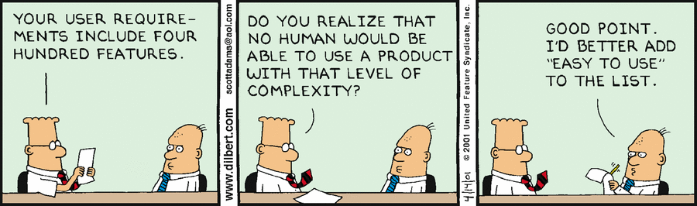
Focus Is on User Requirements
Darwinian Data Structure Selection Speaker: Michail Basios
Notes:
Time pressure of industrial software development
Optimisation can be tedious and pointless.
- Optimisation is time consuming.
Optimisation may be expensive and the benefits unclear for many projects and thus may be neglected.
So developers react by “Leave it for later”
ent,.

Slide 4
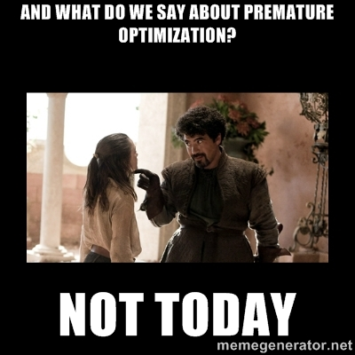
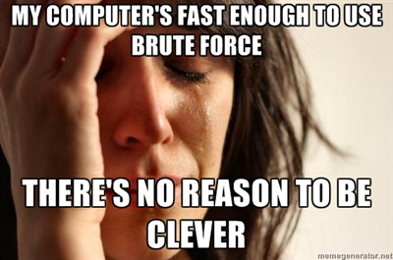
It’s Not Just Pre-optimization
Darwinian Data Structure Selection Speaker: Michail Basios
Notes:
But sometimes the optimisation is essential.
Developers prefer quick and dirty solutions
Those solutions lead to overhead.
However, when the scope of the application changes this solution may not be feasible anymore (e.g. the size of the input huge datasets increases significantly)

Slide 5
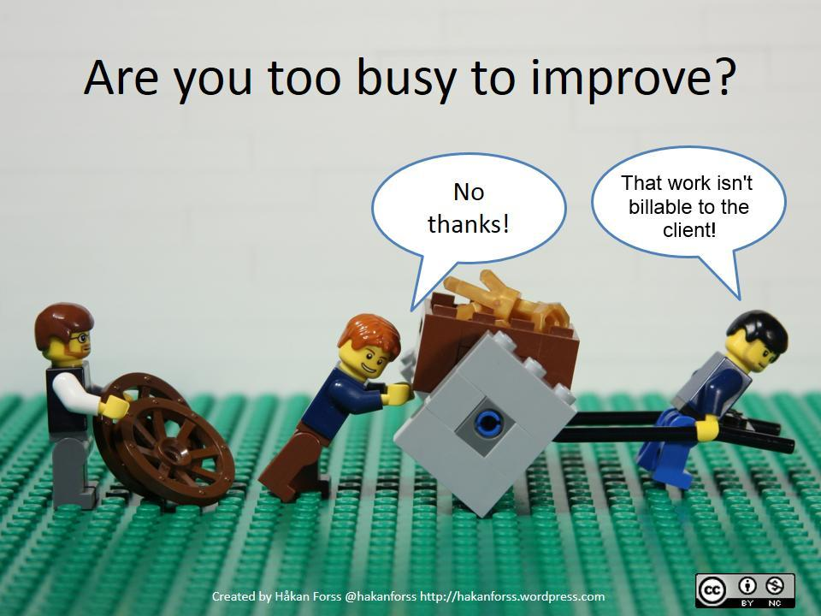
Optimisation Can Be Beneficial
Darwinian Data Structure Selection Speaker: Michail Basios
Notes:
- Optimisation can be very beneficial.

Slide 6
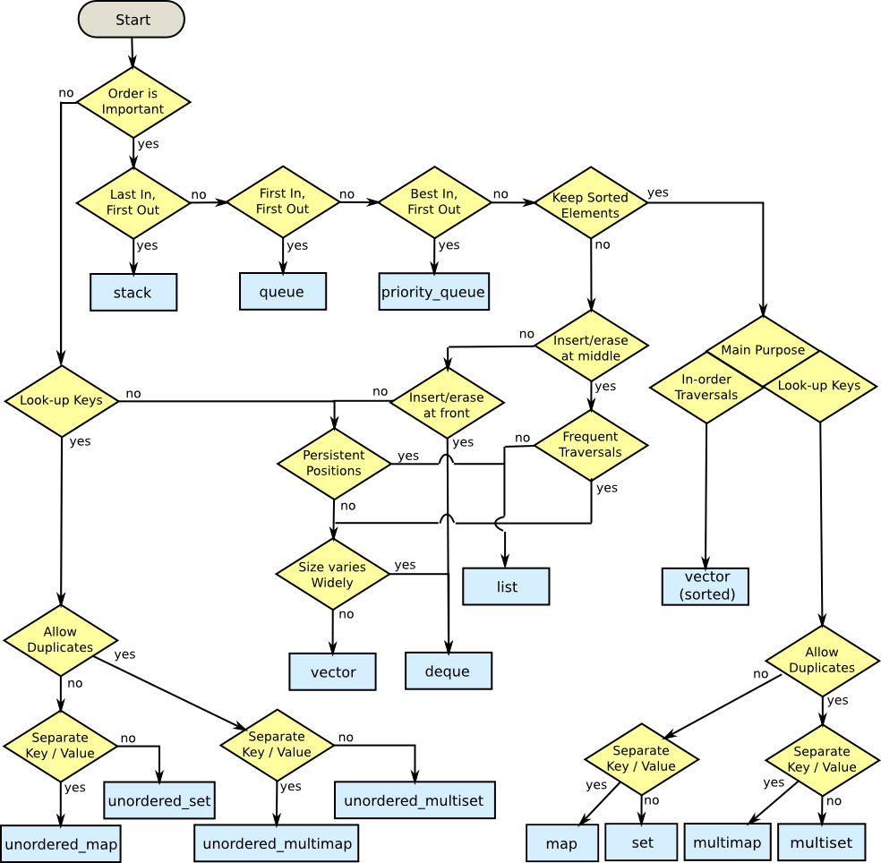

Data Structure Selection/Optimisation Process
Hmmm, maybe just use defaults that work in most cases.
Darwinian Data Structure Selection Speaker: Michail Basios

Slide 7
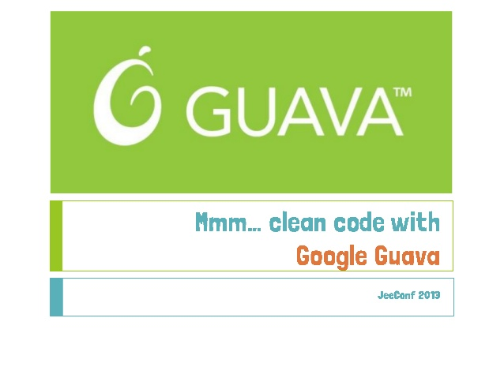


Darwinian Data Structure Selection
ARTEMIS
Corpus: 43 projects
4.8% median execution time improvement
10.2% median less memory consumption
5.1% median less CPU usage
  13% execution time improvement
  9% less memory consumption
  4% less CPU usage
- 23.5% less memory consumption (without affecting other measures)
- 16.5% less memory consumption (without affecting other measures)
A framework for multi-objective code optimisation Speaker: Michail Basios

Slide 8
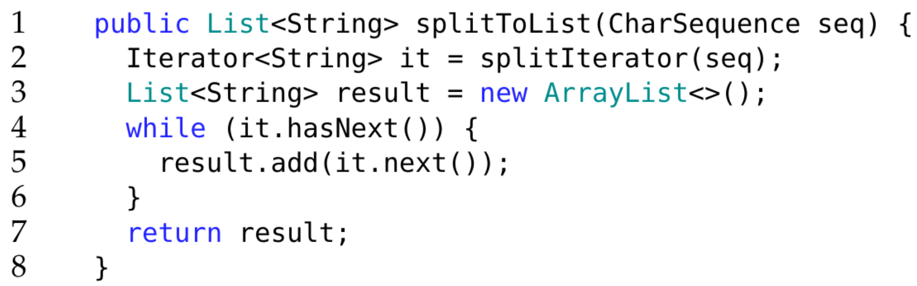
Motivating Example
Data Structure Implementation
Size Parameter
A function from the Splitter class of Guava Library
Darwinian Data Structure Selection Speaker: Michail Basios
Notes:
Invode by other methods
=

Slide 9
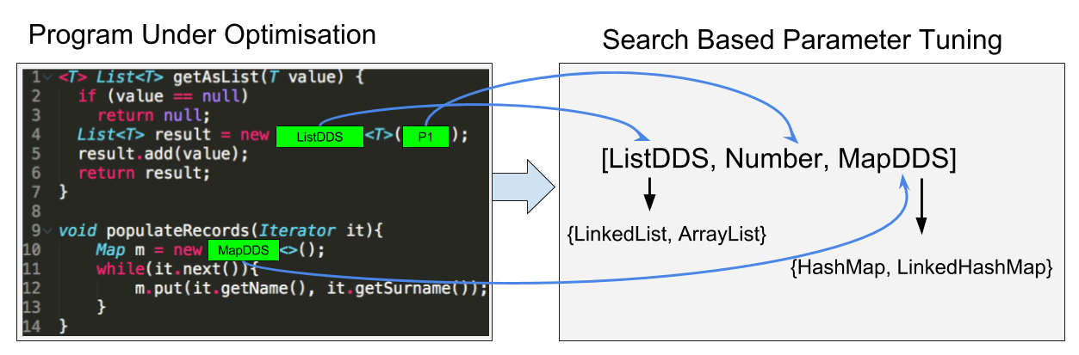
Artemis searches a program’s space of Darwinian Data Structure holes for optimal implementations and configurations.
Darwinian Data Structure Selection Speaker: Michail Basios
Notes:
We formulize the problem for selecting and tuning the data structures as follows:
DDS: A set of implementations that share a common interface and are interchangeable.
Candidate Program: Different implementation of a DDS can be used in place of others wherever they are used in a program. The set of program points that use a particular instantiation of a DDS are the holes that we try to fill.
For a set of interchangeable data structures, given a program that uses those, we search the space of their interchange configurations.
DSS searches a program’s space of DDS holes for optimal implementations and configurations

Slide 10
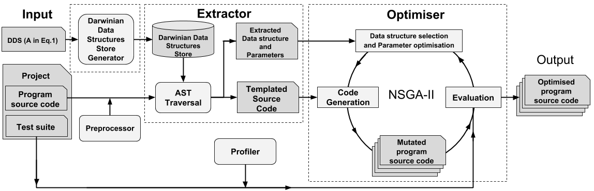
Architecture of Artemis
Source to Source Transformation
Darwinian Data Structure Selection Speaker: Michail Basios

Slide 11
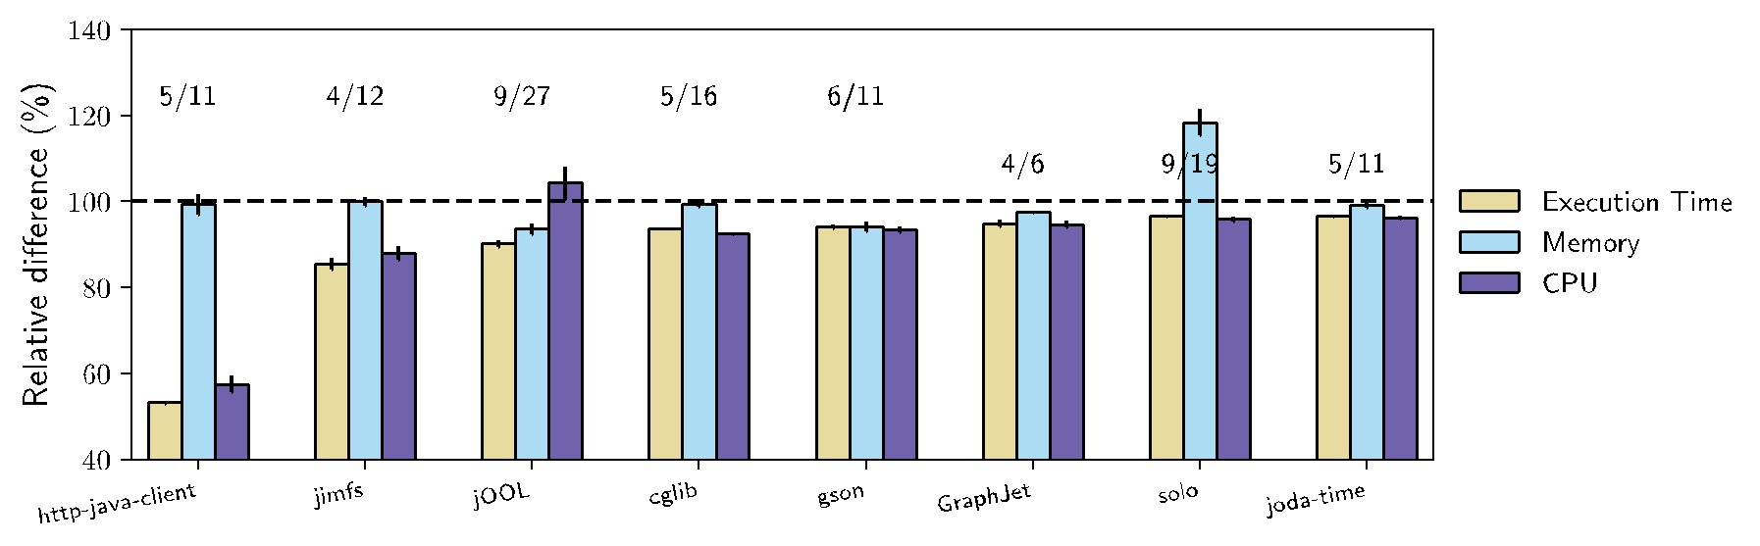
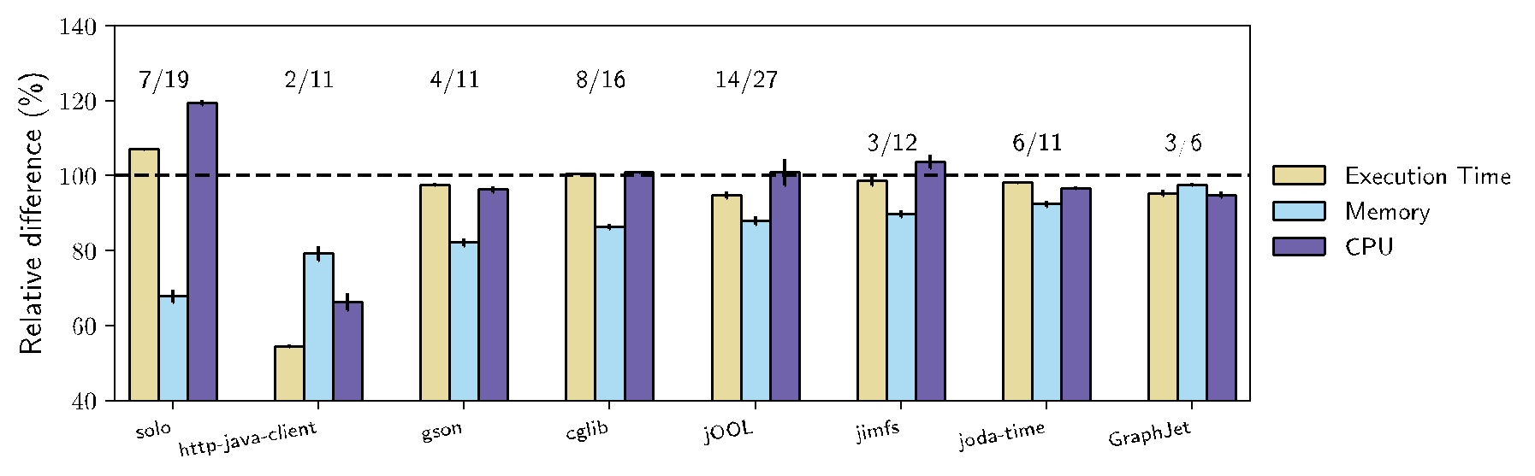
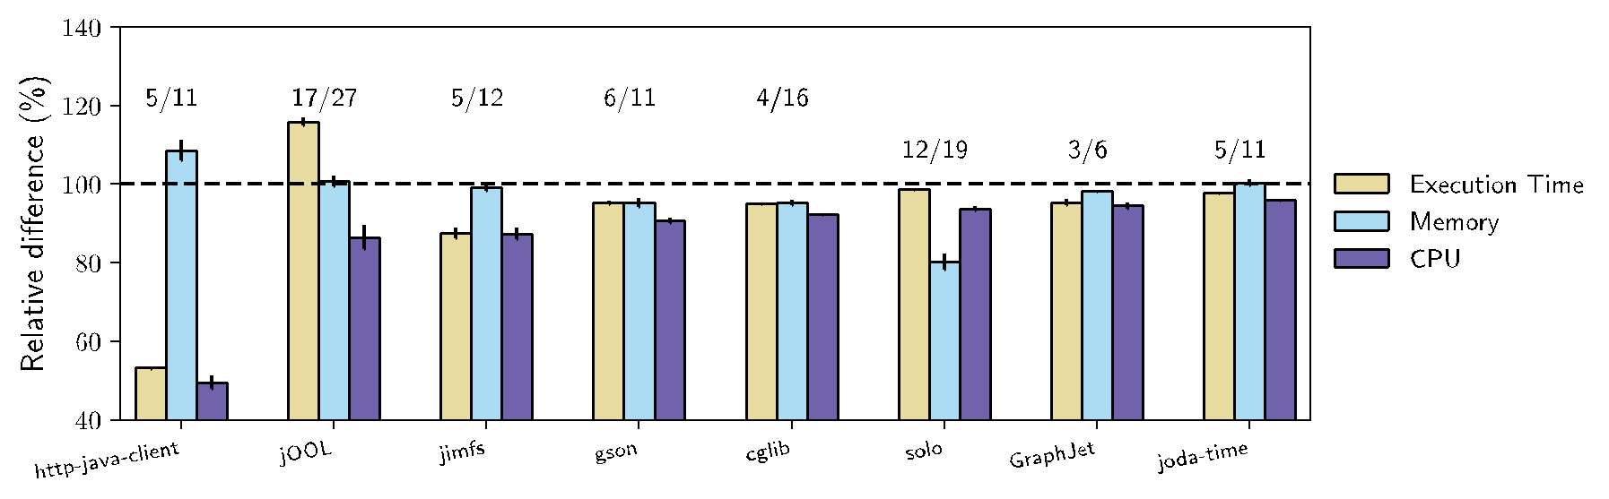
What is the improvement that ARTEMIS provides for each measure?
Best improvements per measure
Execution Time: 4.8 %
Memory Consumption: 10.2%
CPU usage: 5.1%
Popular GitHub projects
Darwinian Data Structure Selection Speaker: Michail Basios

Slide 12

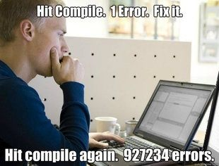
Cost of Artemis
Average optimisation process -> 3.05 hours
Azure cost -> £ 0.41 per hour
Artemis cost
≪
Software Engineer Cost
ARTEMIS
Darwinian Data Structure Selection Speaker: Michail Basios

Slide 13
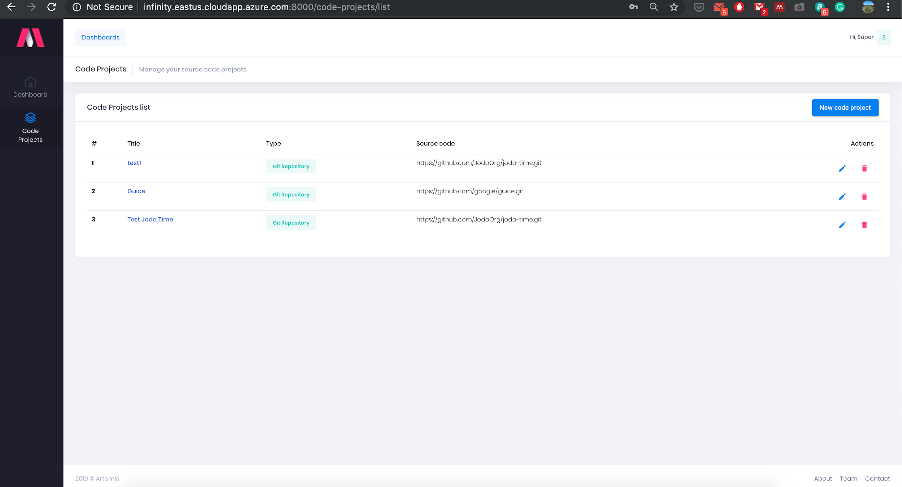
Artemis as a Web Service
Artemis Web-Based Dashboard
Darwinian Data Structure Selection Speaker: Michail Basios

Slide 14
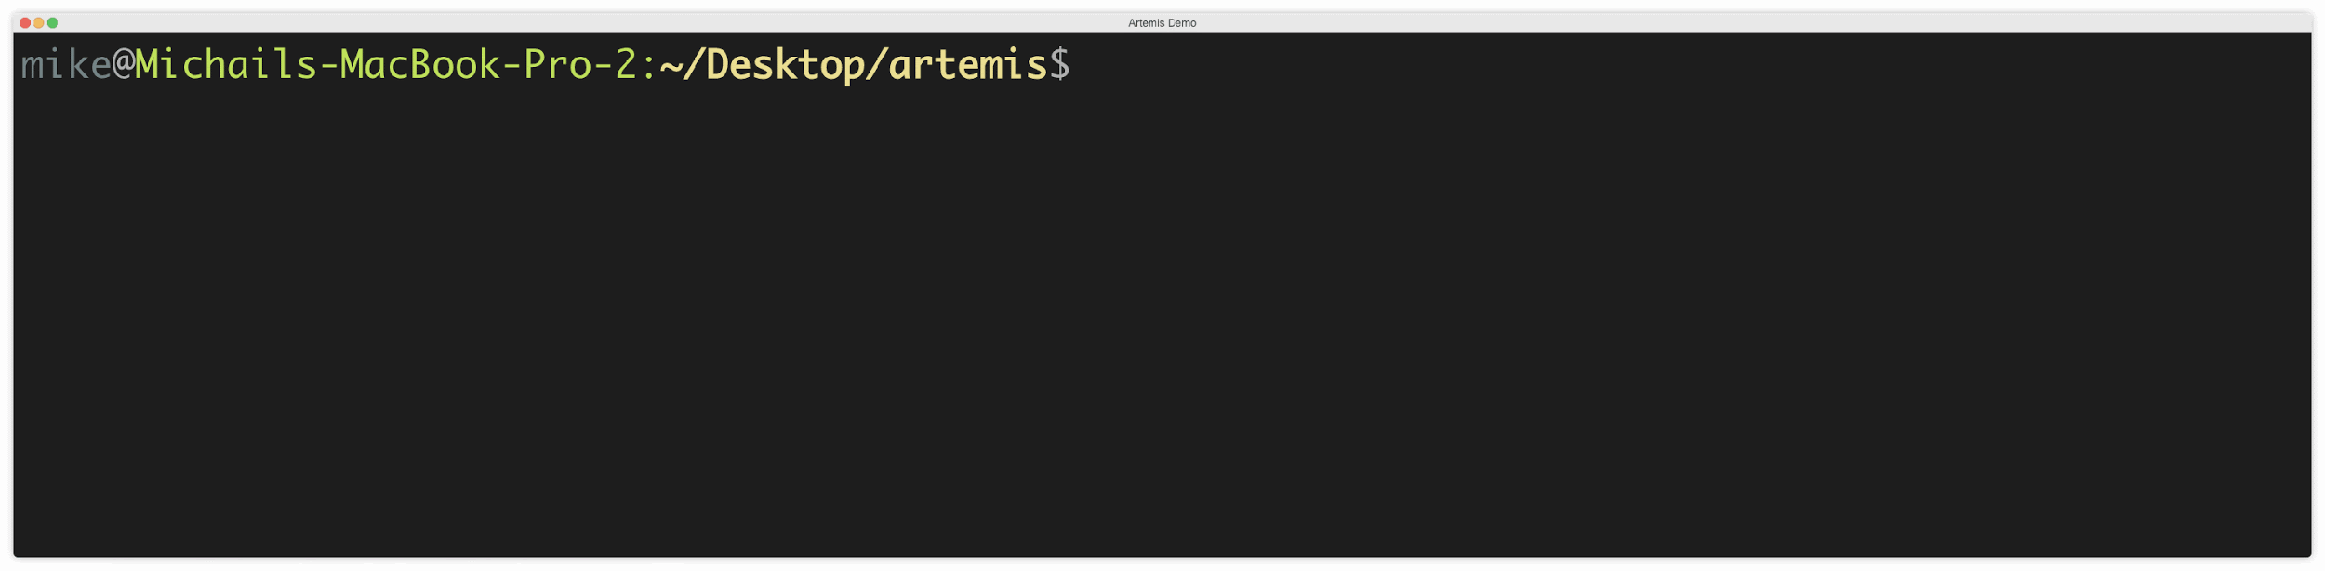
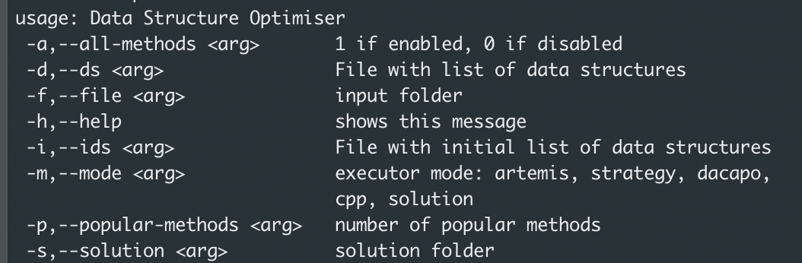
Artemis as a Command Line Tool
Darwinian Data Structure Selection Speaker: Michail Basios

Slide 15
What makes Artemis cool?
Easy to use as it automatically identifies and tunes the data structures and corresponding parameters of a program
Easy adaptable (String Buffer vs String Builder)
Multiple languages (Java, C++, Scala, etc)
Multi Objective optimisation on programs used by thousands of users
It can scale on the cloud and provide fast optimisations
Potential to be a very nice cloud service connected with Git
Darwinian Data Structure Selection Speaker: Michail Basios

Slide 16

ARTEMIS | HUMANS
Can automatically and fast scan thousands of lines of code and tune data structures | Will take significant amount of time to identify and change potential under-optimised data structures
Very cheap and easy to use | Can be very costly and time consuming
Found optimisation opportunities and improved highly optimised code by humans (open-source programs such as Guava) | Had neglected optimisation opportunities
Applicable on other domains (i.e., algorithmic trading) | Need domain knowledge
Darwinian Data Structure Selection Speaker: Michail Basios

Slide 17
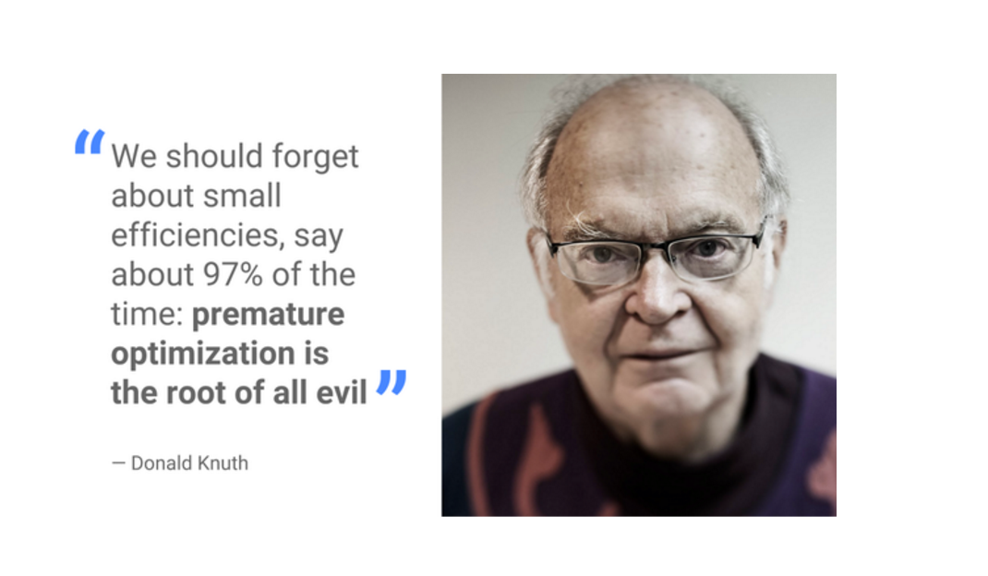
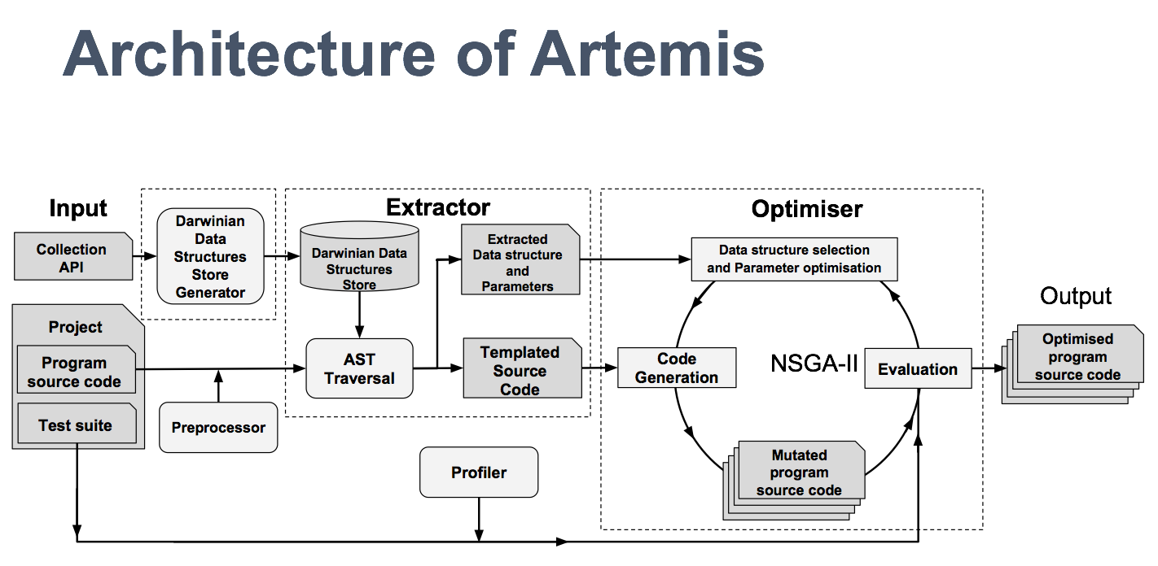

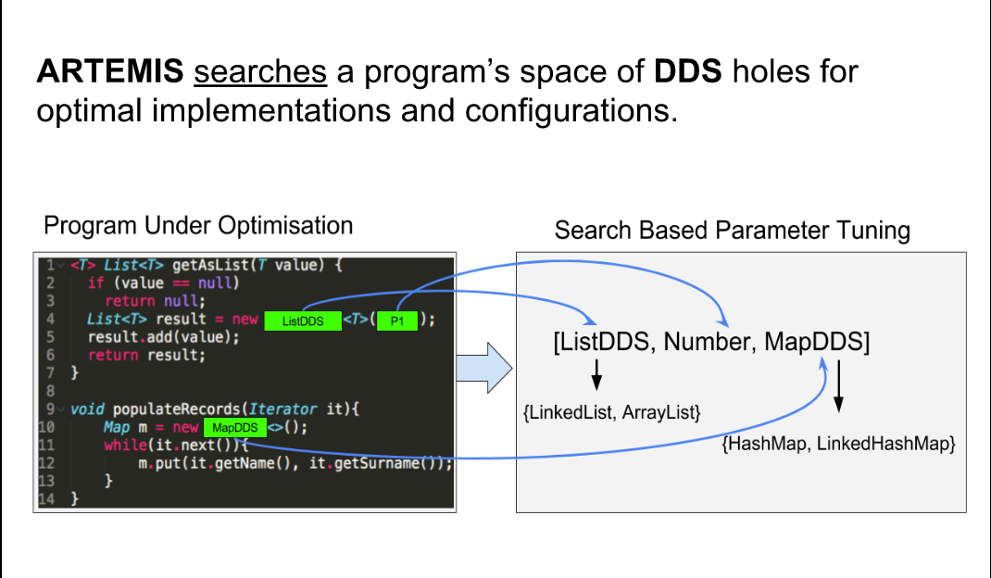
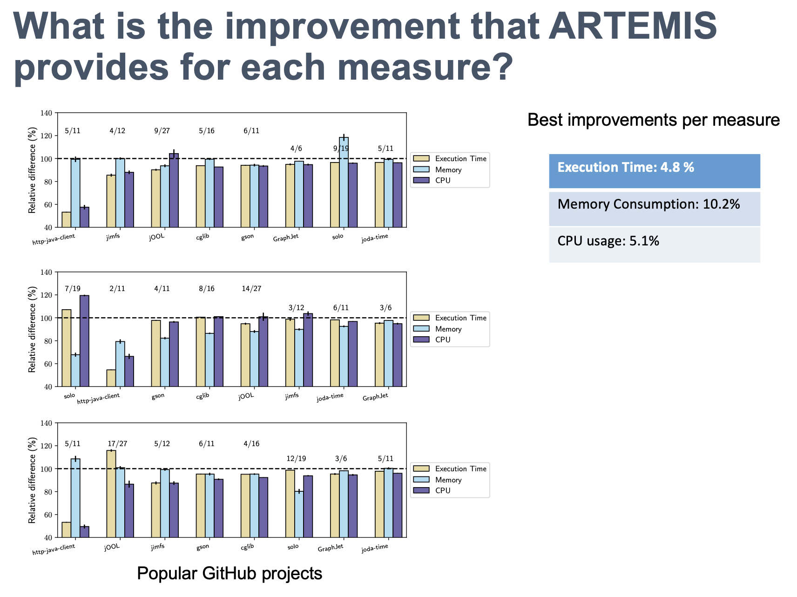
Darwinian Data Structure Selection
Darwinian Data Structure Selection Speaker: Michail Basios

