Slide 1

Truss Optimisation in
Grammatical Evolution
Dr. Michael Fenton
Michael.Fenton@ucd.ie

Slide 2
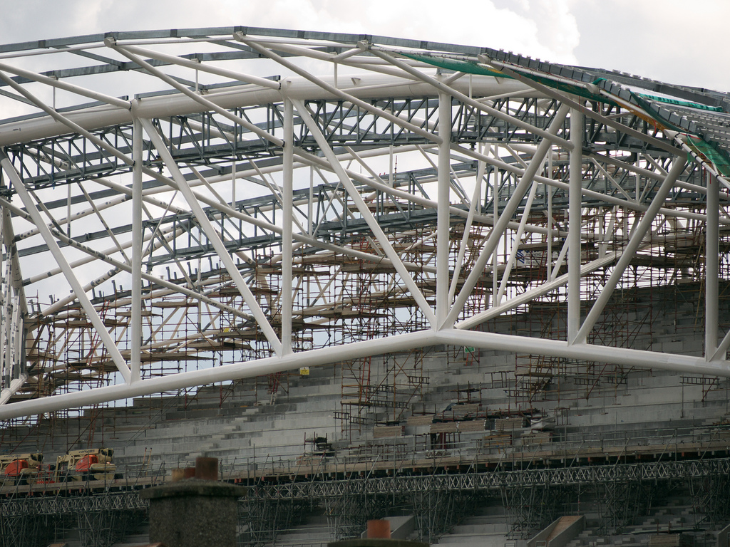
Housekeeping: What is a truss?
Notes:
Apparently some people might not know this.

Slide 3
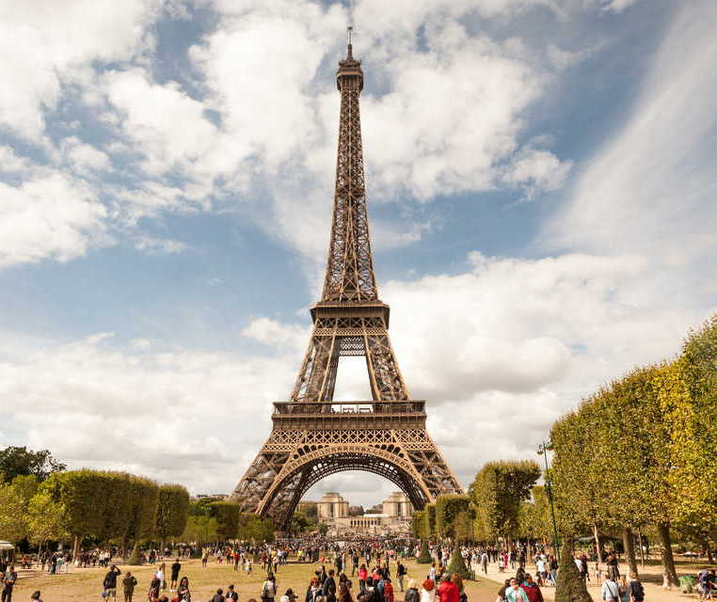
Why is this important?
Eiffel Tower
  7,300 tons
  Wrought Iron
  10% weight saving = 730 tons
Savings “snowball” and scale down through entire structure
  Lighter structure needs less support, etc.
Notes:
Eiffel tower: Hand designed!!!!!

Slide 4
Why Human-Competitive?

Slide 5
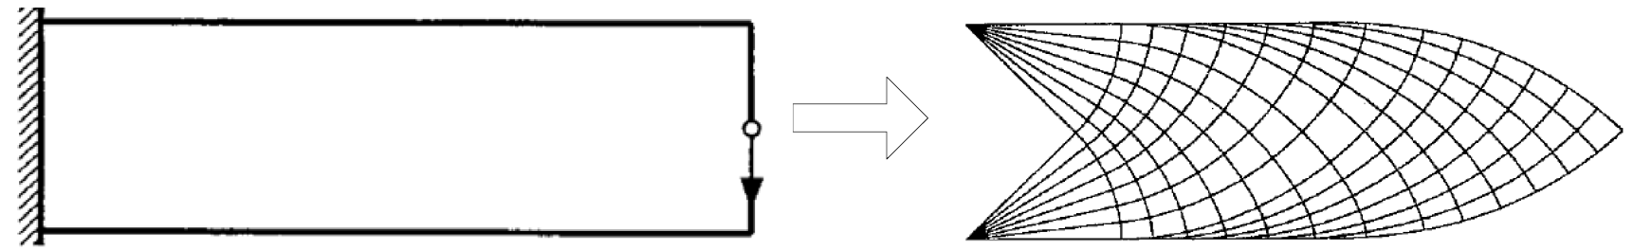
Theoretical Limitations
Michell, A.G.M., 1904. LVIII. The limits of economy of material in frame-structures. The London, Edinburgh, and Dublin Philosophical Magazine and Journal of Science, 8(47), pp.589-597.
Notes:
The literature has an extensive history stretching back to 1904 - Anthony George Maldon Michell
Idea with Michell truss is that forces don’t generally move in straight lines (unless applied axially with reactions).
Ideal Michell truss has infinite bars, infinitely small, all intersecting at right angles with one another.
The closer to right-angle intersection, the better the performance.
Follows principal stress lines.
Impossible structures!
If the theoretical best contains infinite info, there is ALWAYS a better solution out there.
a succession of increasingly more refined and iteratively better results.
No activity really possible until 50 years later, with the advent of computers.
Human performance has long been outstripped by iteratively better adapted algorithms. Takes an order of hours to design a truss by hand. Can be done in milliseconds by computer.

Slide 6
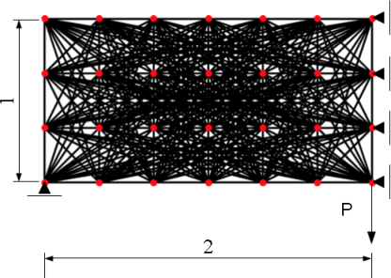
Traditional Ground Structure
Image credit: [4]
Notes:
These techniques vastly out-perform humans. No real way to quantify.

Slide 7
Traditional Ground Structure
Nodes = n
Connections c = ((n-1)n)/2
Permutations = tetrahedral number +
number of connections
= ((c-1)*c*(c+1))/6 + c
~ O(n⁶)
Notes:
n 10 = 15,225
n 100 = 20,214,566,625
n 1,000 = 2 * 10^16
n 10,000 = 2 * 10^22
n 100,000 = 2 * 10^28
etc.
This is an over-estimation! Favors this representation.
Vast majority of solutions this can make will just fall down! Not structurally viable at all!

Slide 8
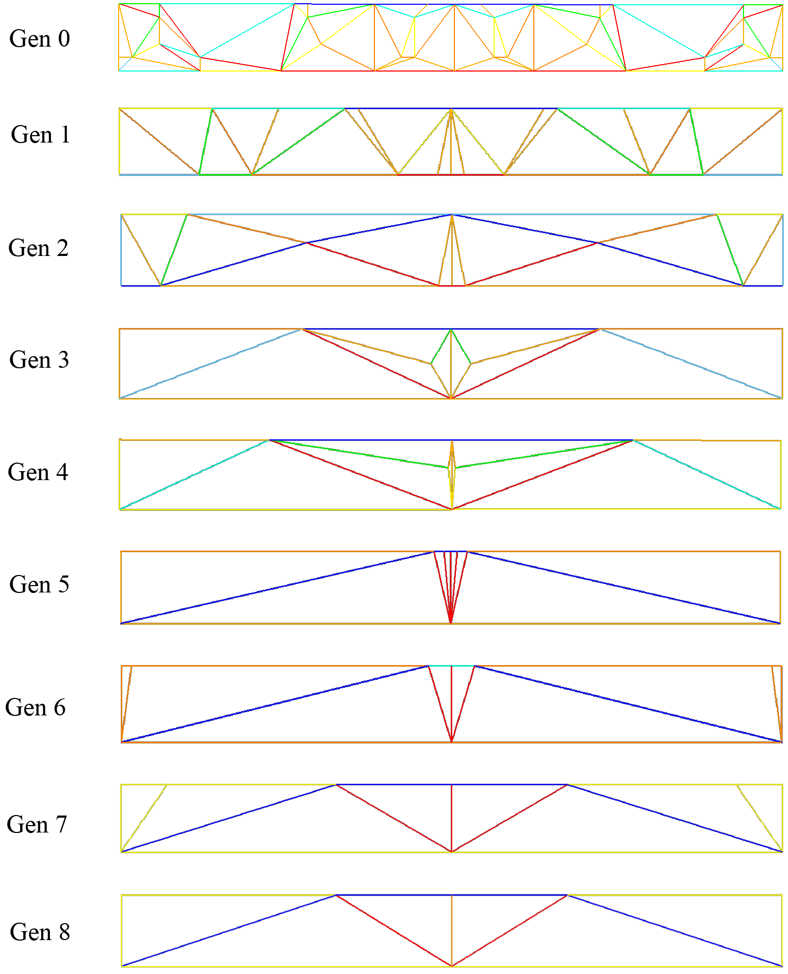
SEOIGE [2]
Blue = Compression
Red = Tension
Notes:
We have changed the representation of the problem to greatly increase the degree of freedom with which problems can be generated.
Allow grammar to recursively select number of nodes within design space
Connect nodes deterministically using triangulation algorithm
All solutions guaranteed to be structurally stable!!!
Results are equal to or better than all examined techniques from 8 of the most recent literature on all examined problems.

Slide 9
SEOIGE [2]
Recursive node-based grammar:
  a ::= [<nodes>]
  <nodes> ::= <node> | <node>,<nodes>
  <node> ::= [<%>, <%>]
  <%> ::= <n><n>.<n><n>
  <n> ::= 0|1|2|3|4|5|6|7|8|9
10^{8*(d-2)} unique solutions at depth d
Notes:
Minimum path of 3
d3 = 100,000,000
d4 = 10,000,000,000,000,000 (1,000 bars)
d5 = 1,000,000,000,000,000,000,000,000
etc.

Slide 10
Why Best HUMIES Entrant?

Slide 11
Why Best HUMIES Entrant?
The methods described in paper [2] represent an entirely new way to generate truss structures, previously unseen in the literature.
Intelligent, lightweight representation.
  Use of triangulation: all generated solutions are kinematically stable, and as such are structurally viable (constraints notwithstanding).
Pinnacle of engineering optimisation after over 100 years of research in the field.
Real-world application with commercial appeal.
  Designed with this in mind.
  Real-world materials and constraints.
Notes:
B ("The result is equal to or better than a result that was accepted as a new scientific result at the time when it was published in a peer-reviewed scientific journal.")
E ("The result is equal to or better than the most recent human-created solution to a long-standing problem for which there has been a succession of increasingly better human-created solutions.")
G ("The result solves a problem of indisputable difficulty in its field.")

Slide 12
Sustainable Development
Minimizing material usage has a number of benefits:
  Immediate cost benefit.
  “Snowball” effect of weight reduction over entire structure.
  Material minimisation: effect on supply and demand.
    With an average estimate of 2 tons of CO2 being emitted for every 1 ton of steel produced [5], any reduction in production has significant environmental implications.
Notes:
Cost benefit: Less material = more savings
Reduction in self-weight of a single structure reduces the stresses imposed on the rest of the structure, thus allowing the rest of the structure to be downsized. When multiple components of a structure can be optimised, the effect snowballs to produce large scale savings across the entire overall structure.
Minimising material usage diminishes demand, which in turn dictates a reduction in supply.

Slide 13
Acknowledgements
This research is based upon works supported by Science Foundation Ireland under grant 13/IA/1850.

Slide 14
References
Fenton, M., McNally, C., Byrne, J., Hemberg, E., McDermott, J. and O'Neill, M., 2014. Automatic innovative truss design using grammatical evolution. Automation in Construction, 39, pp.59-69.
Fenton, M., McNally, C., Byrne, J., Hemberg, E., McDermott, J. and O’Neill, M., 2016. Discrete planar truss optimization by node position variation using grammatical evolution. IEEE Transactions on Evolutionary Computation, 20(4), pp.577-589.
Michell, A.G.M., 1904. LVIII. The limits of economy of material in frame-structures. The London, Edinburgh, and Dublin Philosophical Magazine and Journal of Science, 8(47), pp.589-597.
Torii, A.J., Lopez, R.H. and Miguel, L.F., 2016. Design complexity control in truss optimization. Structural and Multidisciplinary Optimization, 2(54), pp.289-299.
Global CCS Institute, 2013. CCS for iron and steel production. Available online at: https://www.globalccsinstitute.com/insights/authors/dennisvanpuyvelde/2013/08/23/ccs-iron-and-steel-production

