Slide 1


A Hybrid Method for Feature Construction and Selection to Improve Wind-Damage Prediction in the Forestry Sector
Emma Hart¹, Kevin Sim¹
Barry Gardiner², Kana Kamimura³
1 Edinburgh Napier University
2 ISPA, INRA, Bordeaux Sciences Agro
3 Institute of Mountain Science,Shinshu University

Slide 2
Problem Context
In Europe more than half of all the damage to forests by volume is due to wind
  and there is a worrying increasing trend in damage levels due to climate change
Understanding the process of wind interactions with forests and the potential for preventive responses is critical:
  for people engaged in the forest based economy
  for forest ecologists
  for regional planners and anyone concerned with the continued sustainability of forests and the forestry sector.
This work provides state-of-the-art models for predicting wind-damage to individual trees that informs forest management techniques

Slide 3
Why it matters: impact of storm damage
Economic
  Every year across Europe, the number of trees that commercial forests lose to storms is equivalent to the annual amount of timber felled in Poland.
  1999: Storm Martin- 26 million m³ of timber loss in south-west France - equivalent to the general harvested volume for 3.5 years
  2009: Storm Klaus damaged 37 million m³ of pine trees, leading to direct losses of approximately €1.8 billion in the forestry sector - 60% of total economic losses due to natural causes in France that year
34 km
Timber lost in Storm Lothar

Slide 4
Why it matters: impact of storm damage
Environmental
  enormous impact on the carbon balance of forests
  important to consider when carbon sequestration is embedded in forest management objectives
Social
  (direct) loss of income for forest owners
  (indirect) loss of power or mobility due to trees falling on power lines

Slide 5
Mitigation: forest management
Forest management can successfully reduce the risk of wind damage
Main approach is thinning: selective removal of trees to reduce stand vulnerability
Need to understand which trees to thin to minimise damage
Currently, industry “stuck” as does not have accurate enough models to make decisions, especially in large areas
Images from https://www.nrs.fs.fed.us/fmg/nfmg/fm101/silv/index.htm

Slide 6
Why this is the best
Data from 2 French forests following storms
Addresses an important economic, environmental, & social problem
Provides a step-change in ability of foresters to plan due to accuracy of new model
  allows forest-researchers to make large scale evaluations, scenario modelling, etc
Provide forest managers and regional planners with options for deciding on future strategies.
Use GP to evolve a large set of new features
(as functions of existing measured features)
>15% improvement in accuracy c.f. previous models
Random-Forest Classifier built with VSURF for feature selection

Slide 7
Why it is human competitive
E: The result is equal to or better than the most recent human-created solution to a long-standing problem for which there has been a succession of increasingly better human-created solutions.
2000
2017
GP +
VSURF +
Random Forest
Mechanistic models
Mechanistic +empirical
Statistical
Machine-learning
Some images from http://talk-technology.blogspot.com/2012/01/simulation-from-high-resolution-forest_1440.html

Slide 8
Why it is human competitive
(B) The result is equal to or better than a result that was accepted as a new scientific result at the time when it was published in a peer-reviewed scientific journal:
2015
2016
Nezer Forest: 90% accuracy
(+17.6% improvement)
Aquitaine Forest: 79% accuracy
(+15% improvement)
Hale et al. “Comparison and validation of three versions of a forest wind risk model, Environmental Modelling & Software, Volume 68, 2015
Kamimura et al. "Mechanistic and statistical approaches to predicting wind damage to individual maritime pine (Pinus pinaster) trees in forests.”
Canadian Journal of Forest Research 46.1 (2016)

Slide 9

Why it is human competitive
(D) The result is publishable in its own right as a new scientific result independent of the fact that the result was mechanically created.
Provides an accurate model that can inform development of new management policies
The evolved features highlight relationships between original feature – can provide scientific insight into models

Slide 10
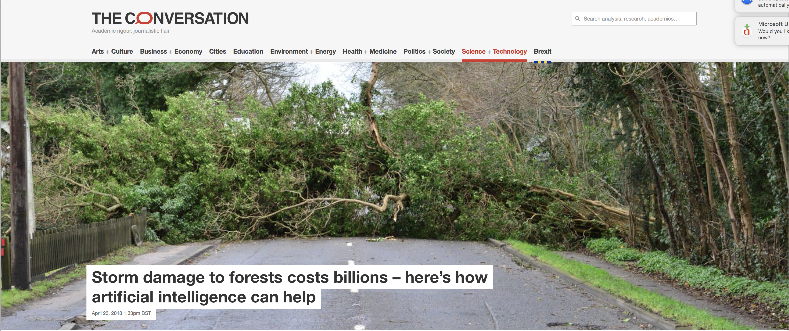

Summary
3187 reads since April 23rd
Storm damage to forests has huge economic, environmental and social impact.
Our approach provides the best-known model for predicting damage to individual trees that can inform development forest- management policies
Collaborative work with researchers from Scotland, France, Japan that has impact in all three countries
Impact outside EC community:
  Can be widely applied within the forestry industry (that has typically not used EC/ML techniques)
Impact inside EC community
  new methods for evolving large feature sets in imbalanced data sets
Invited talk, July 2018, Tsukuba, Japan
Presented at conference, 2017, in Boulder USA

