Slide 1

A search-based framework for automatic generation of testing environments for cyber – physical systems
Humies Award Candidate 2022
Dmytro Humeniuk, Foutse Khomh, Giuliano Antoniol
SWAT lab, Polytechnique Montreal, Canada
Notes:
My name is Dmytro Humeniuk and I’m a PhD student at Polytechnique Montreal. It’s my big honour to present our work on test scenario generation for autonomous cyber-physical systems for Humies Awards.
This work was done under the supervision of my research directors Foutse Khomh and Giuliano Antoniol

Slide 2
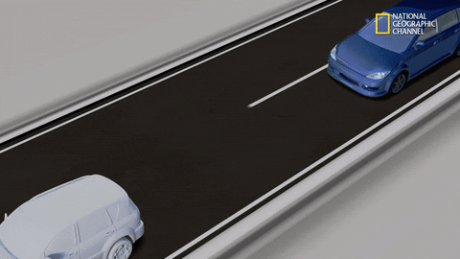
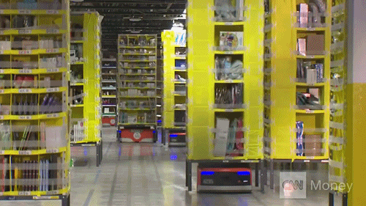
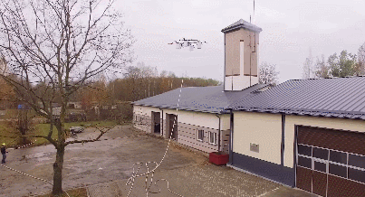
Autonomous systems
These systems can make our lives safer and easier…
Autonomous driving systems:
Reduce the frequency of accidents by 90% by 2050 = 30 000 lives a year (KPMG [1] )
Reduce total losses from car accidents by 63 % = 122-billion-dollar in losses (KPMG report) [1]
60% drop in harmful emissions [2]
Possibility of driving for people with disabilities
Autonomous robotic systems:
Increase efficiency and productivity
Improve safety for employees in high-risk work environments
Self-driving car
Robots at Amazon warehouse
Firefighting drones
For the image sources see refences [1]-[3]
Notes:
Autonomous systems are an active research area today. And that’s because they can make our lives safer and easier.
For example, let’s look at some predicted benefits from using the self-driving systems….
And the benefits of robotic systems:
Proper testing is crucial to reap the benefits, to ensure…
Safer cars, combined with less costly

Slide 3
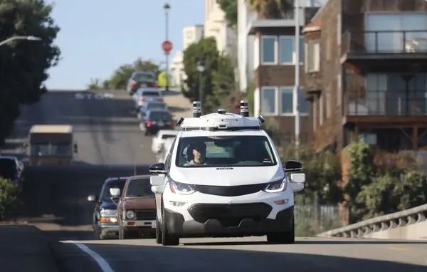
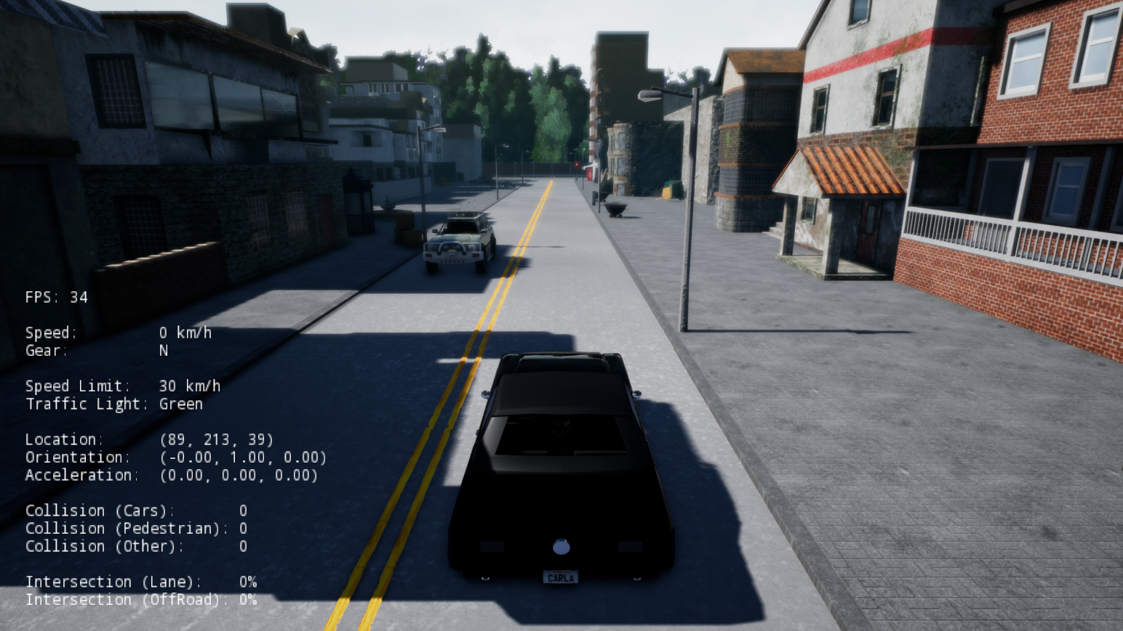
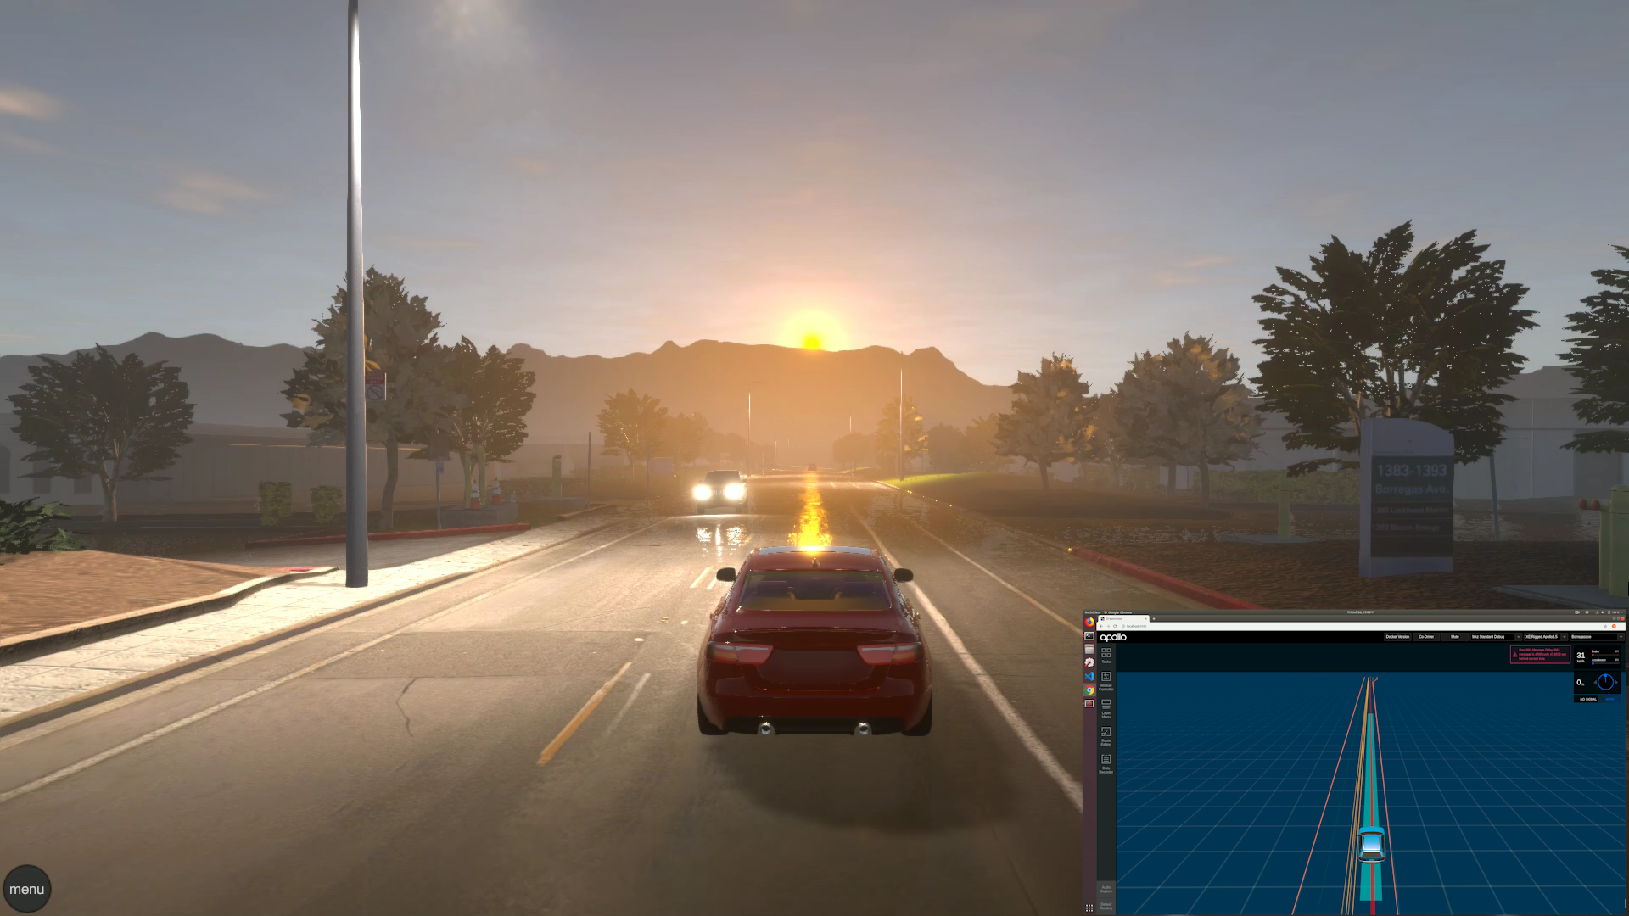
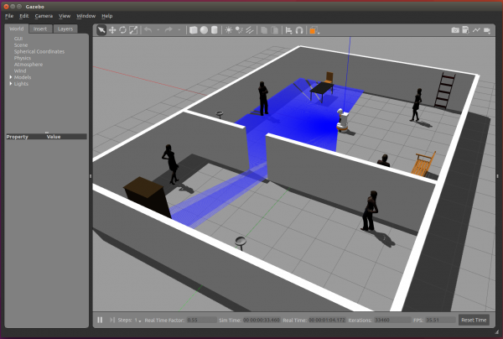
Testing autonomous systems
In order to reap the benefits of these systems we should thoroughly test them…
Testing autonomous systems is challenging…
Hardware-the-loop
Model/software-in-the-loop
CARLA
LGSVL
Gazebo
Expensive
Critical scenarios are rare
Limited number of pre-defined scenarios provided
For the image sources see refences [4]-[7]
Notes:
However, to reap the benefits of this systems and to use them we need to make sure they are safe, by thoroughly testing them.
And testing is rather challenging as there are is a huge number of input parameters that need to be taken into consideration, which cannot be covered
by standard techniques for cyber-physical system testing.
One option is to perform the testing in the real world
4.1 crashes per million miles driven
Another option is using the simulators. There is a number of realistic simulators available such as … however they only
Provide a very limited set of pre defined scenarios. Most often the tester needs to manually
Create additional scenarios.

Slide 4
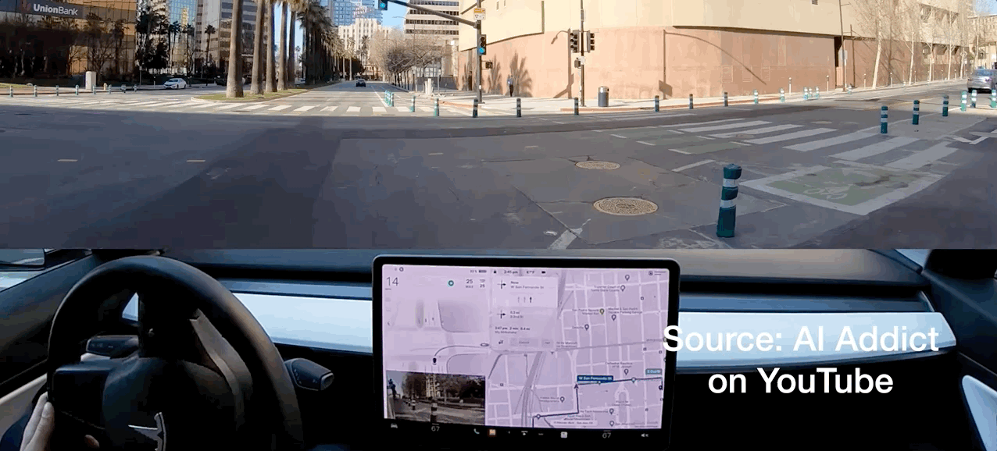
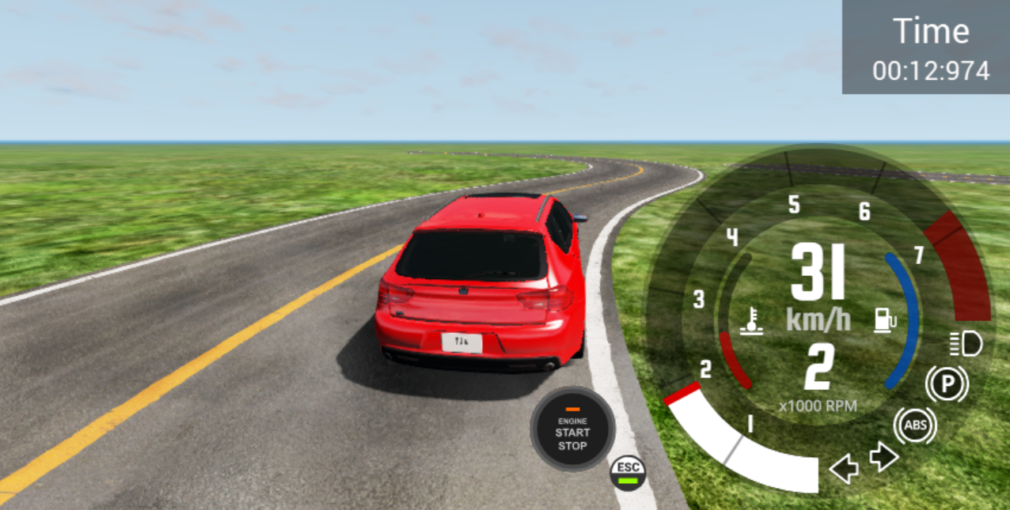
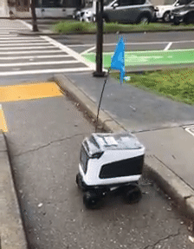
What is a good test scenario alias test case?
Respects the physical constraints of the problem
Reveals unacceptable behavior of an autonomous system
Main challenges
We need to reveal diverse failures
Running simulations is expensive
Tesla autopilot drives into a block pole
Driving agent in the BeamNG.drive simulator
For the image sources see refences [8]-[9]
Autonomous robot gets stuck
Notes:
The space of search is huge

Slide 5



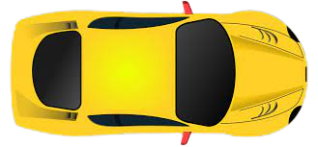


Designing a test case
We need to design a challenging and a realistic test case…
We should consider:
The road topology
Locations, directions and speed of the moving objects
Traffic signs and their locations
Environmental conditions
A big number of parameters and their combinations to consider
We need many diverse test cases
How to explore the search space effectively?
Notes:
A designing a test scenario is quite a complex task for humans.
Let’s look at one example.

Slide 6

Our solution
Using genetic algorithm to generate the test cases automatically
Creating test cases from discrete elements, that can be combined
chromosome = test case
Using the simplified system model to evaluate the individuals
We evolve the test cases to maximize their complexity and diversity with evolutionary search (NSGA-2 algorithm)
Notes:
Our work is dedicated to creating such test cases automatically using a search based approach.
Simply speaking, we suggest resenting the test cases as a sequence of discreet elements that can be combined between each other.
And we encode each test case as genetic algorithm chromosome.
Then we evolve the test cases to maximize their complexity and diversity

Slide 7
Why our result is human competitive ?
Generating test scenarios more effectively, than humans
An example from autonomous vehicle testing…
Producing 494 scenarios in 1 hour, out of which 90 fault revealing
Produce a fault revealing test case every 40 sec – impossible for a human
Notes:
The space of search is huge

Slide 8
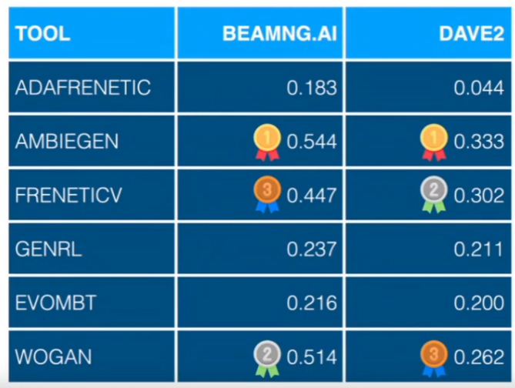
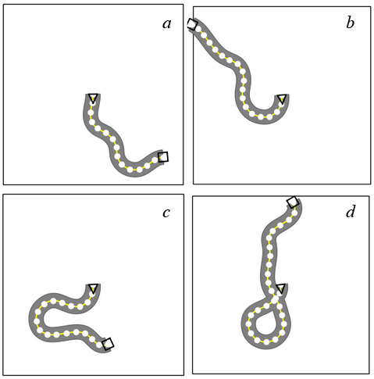
Why this entry is “the best” ?
Our tool AmbieGen is the winner of SBST 2022 Cyber-Physical Systems Testing Tool Competition (co-located with ICSE 2022)
Testing vehicle lane keeping assist system
(H) Criterion
The result holds its own or wins a regulated competition involving human contestants
The goal is to generate challenging, yet valid, virtual roads that cause the test subjects to drive off the lane
Valid (a) and invalid roads (a, b, c)
Notes:
Add more info about competition

Slide 9
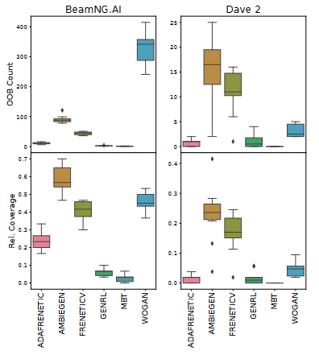
Why this entry is “the best” ?
Our tool (AmbieGen)
Our entry
1st subject | 2nd subject
494.8 | 386.2 | Test cases in 1 hour
90.4 | 14.625 | Fault revealing test cases
Many similar test cases
Improved version of last year winner (FRENETICV)
1st subject | 2nd subject
483.6 | 339.4 | Test cases in 1 hour
44 | 11.125 | Fault revealing test cases
(C) Criterion
The result is equal to or better than a result that was placed into a database or archive of results
SBST2022 tool competition report [10]
Notes:
In this slide I would like to focus more on the results achieved by our tool. The final score was mostly based on the number of produced failures as well as the feature space they cover i.e. their diversity. For the first test subject our tool achieved the highest

Slide 10
Why this entry is “the best” ?
(D) Criterion
The result is publishable in its own right as a new scientific result independent of the fact that the result was mechanically created
Dmytro Humeniuk, Foutse Khomh and Giuliano Antoniol,
A search-based framework for automatic generation of testing environments for cyber–physical systems, Information and Software Technology, Volume 149, 2022, 106936, ISSN 0950-5849, https://doi.org/10.1016/j.infsof.2022.106936.
Dmytro Humeniuk, Giuliano Antoniol, and Foutse Khomh.
AmbieGen tool at the SBST 2022 Tool Competition. In The 15th Search-Based Software Testing Workshop (SBST 2022 ), May 9, 2022, Pittsburgh, PA, USA. ACM, New York, NY, USA, 4 pages. https: //doi.org/10.1145/3526072.3527531

Slide 11
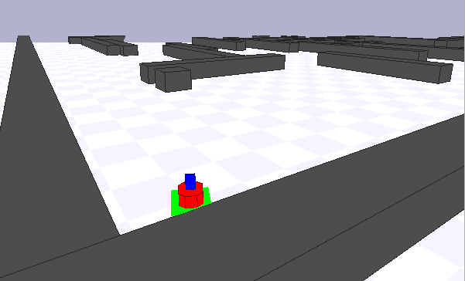
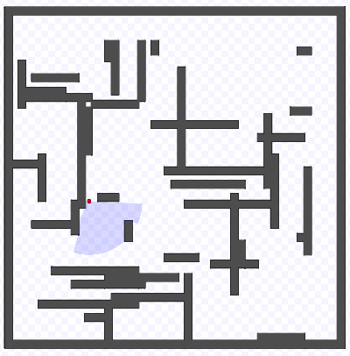
Why this entry is “the best” ?
Test scenario for an autonomous robot
We present a prototype of the framework for designing challenging test cases for different autonomous systems
We provide a state-of-the-art test generating tool, AmbieGen¹, for testing vehicle lane keeping assist system
Our approach reduces the manual effort to produce test scenarios and allows to reveal failures in autonomous systems more effectively
¹https://github.com/dgumenyuk/tool-competition-av

Slide 12

Thank you!

Slide 13
References
https://assets.kpmg/content/dam/kpmg/us/pdf/2017/06/chaotic-middle-autonomous-vehicle-paper.pdf
https://onlinemasters.ohio.edu/blog/the-future-of-driving/
https://github.com/roshanr11/RL-Teaching-A-Quadcopter-To-Fly
https://media2.giphy.com/media/3ohs7M9LtswHUDqPjW/200.gif
https://media1.giphy.com/media/KEkiVTMGEFJrIDM78X/giphy.gif
https://images.squarespace-cdn.com/content/v1/5a31c205d55b41e997de43b6/1612307077806-TEQS3ZEQDE56REA4DP3F/B3-DR401_201904_G_20190410171959.gif
https://robmosys.eu/wiki/_media/baseline:scenarios:tiagogazebo.png?w=600&tok=9ecb51
https://carla.readthedocs.io/en/stable/img/simulator_window.png
https://www.nytimes.com/2018/10/03/business/honda-gm-cruise-autonomous.html
Alessio Gambi, Gunel Jahangirova, Vincenzo Riccio, and Fiorella Zampetti.2022. SBST Tool Competition 2022. In The 15th Search-Based Software Testing Workshop (SBST’22 ), May 9, 2022, Pittsburgh, PA, USA. ACM, New York, NY, USA, 8 pages. https://doi.org/10.1145/3526072.3527538

