Slide 1

Evolving Efficient and Generalizable Multigrid Methods with Grammar-Guided Genetic Programming
19th Annual Humies Awards – 2022 – Boston, USA
Jonas Schmitt, Sebastian Kuckuk, Harald Köstler
Friedrich-Alexander-Universität Erlangen-Nürnberg
Evolving Generalizable Multigrid-Based Helmholtz Preconditioners with Grammar-Guided Genetic Programming, will be presented at GECCO, 2022.
EvoStencils: a grammar-based genetic programming approach for constructing efficient geometric multigrid methods, published in GPEM, 2021.

Slide 2
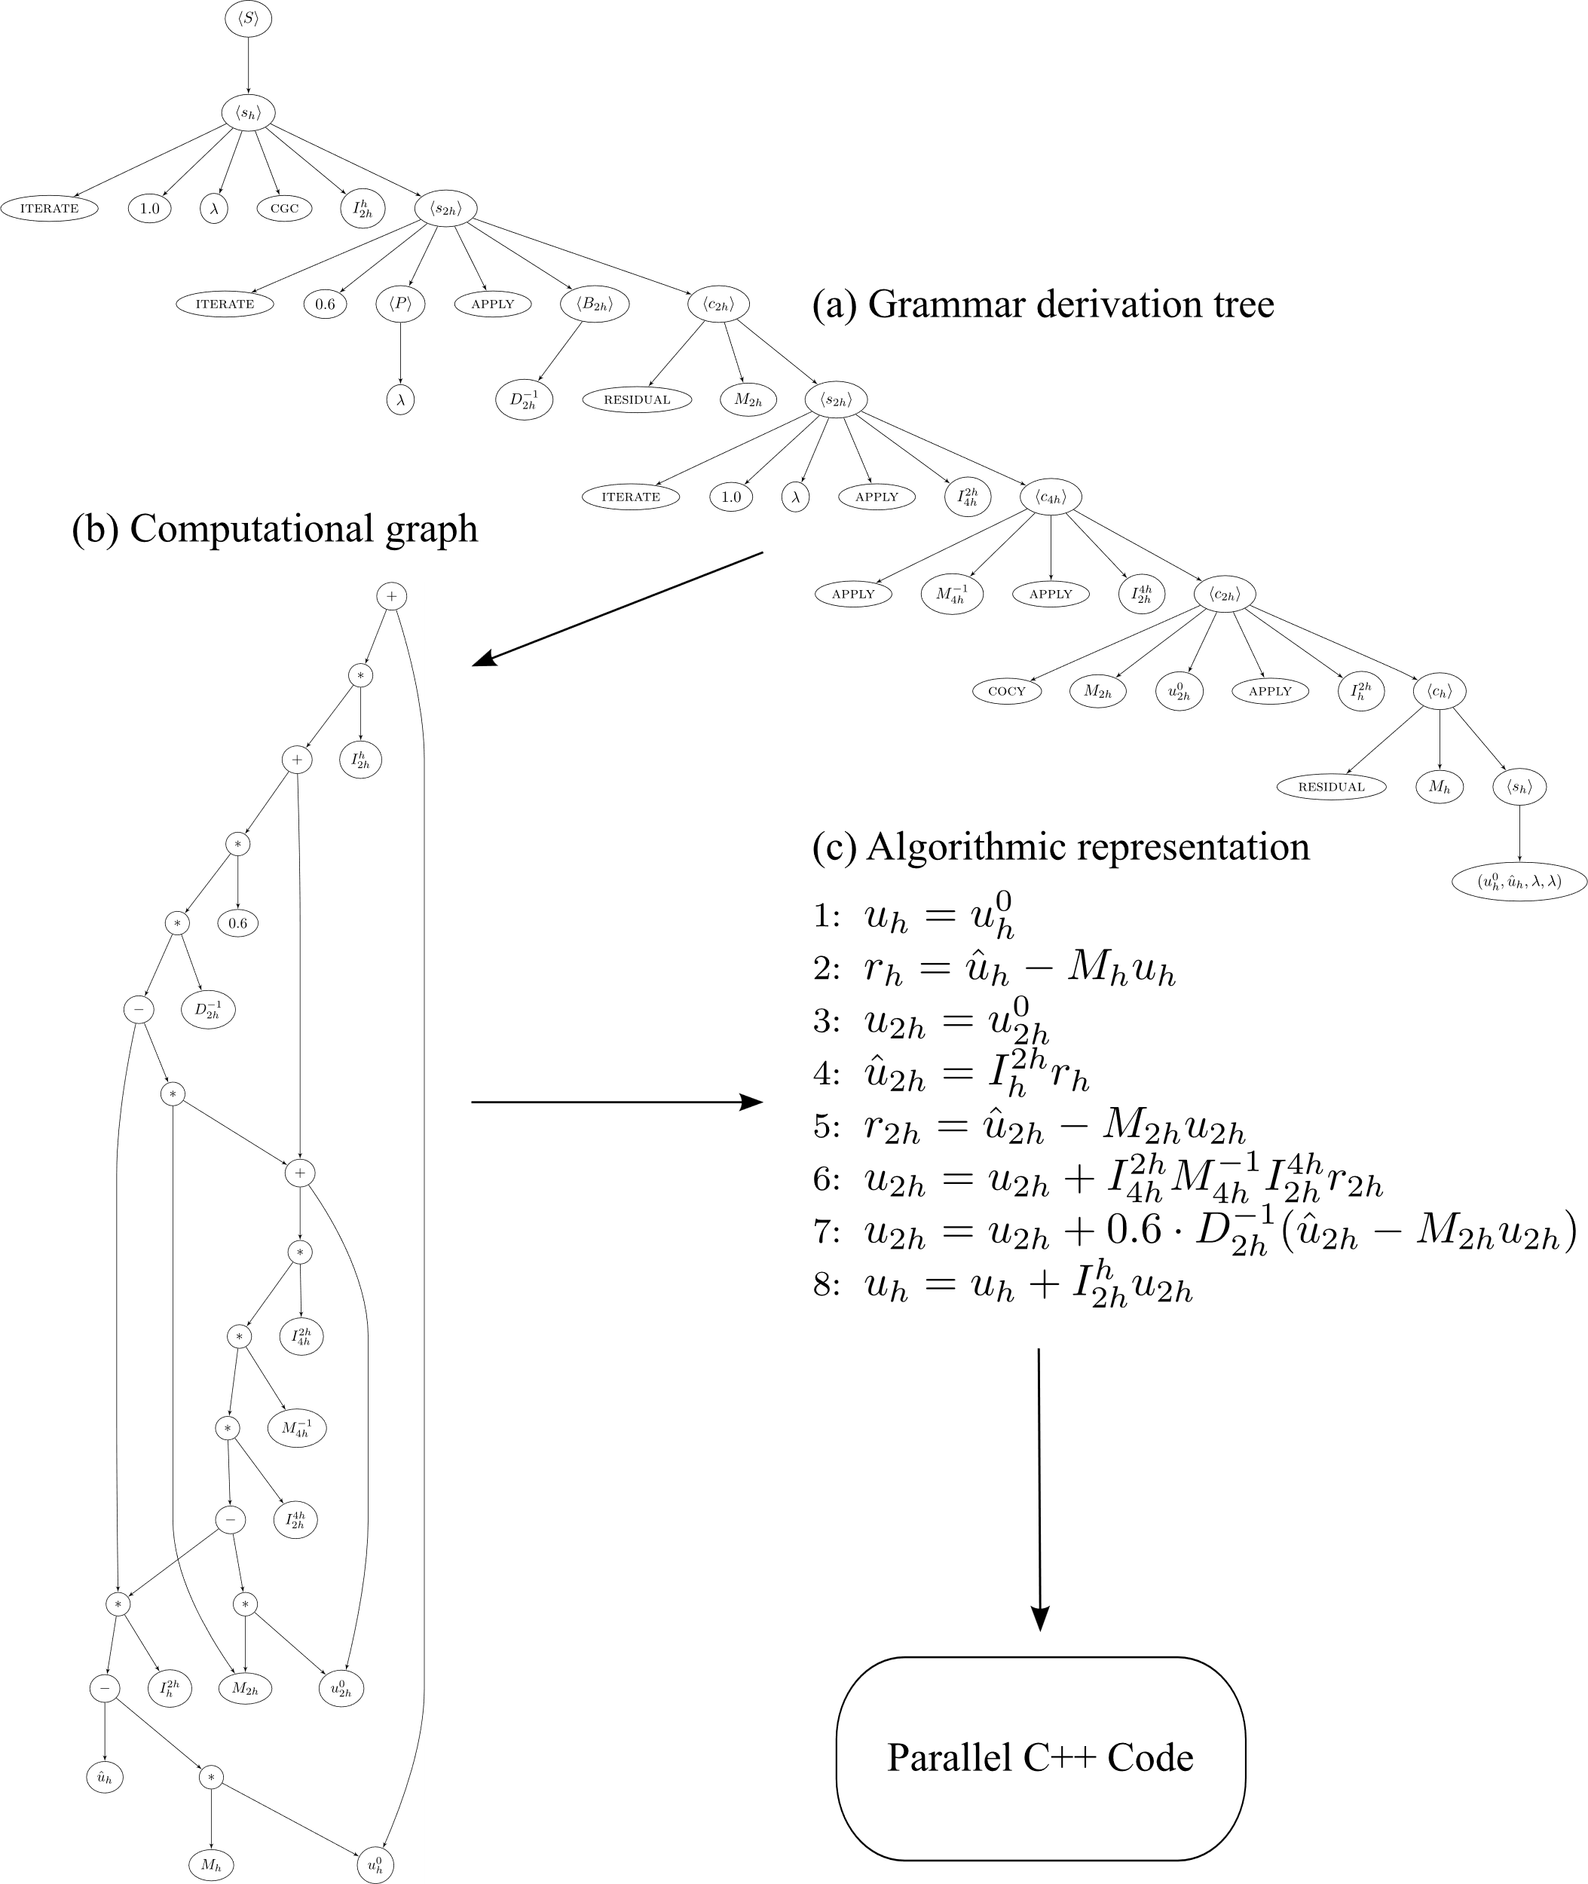
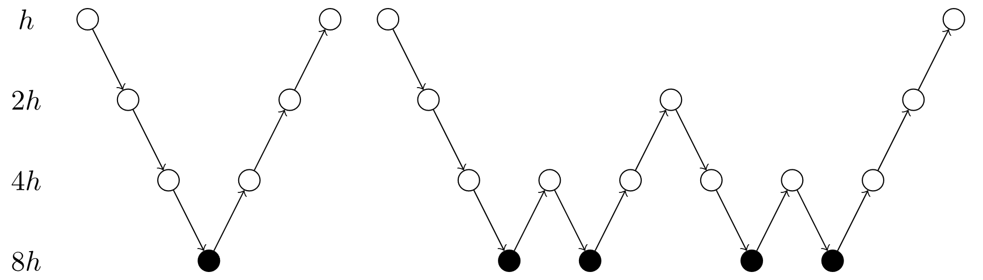
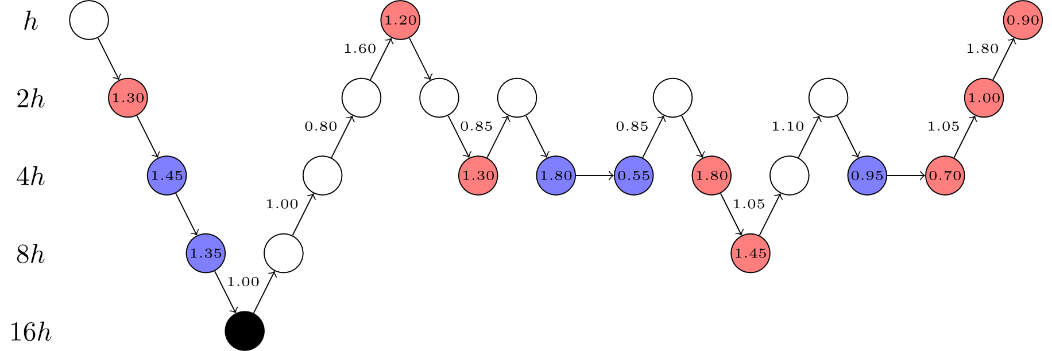
Summary of our Approach
Classical Multigrid Solver Design
Smoother
Restriction
Prolongation
Coarse-Grid Solver
Grammar-Based Multigrid Solver Design
Choose a different operator in each step
Representation of multigrid methods as grammar derivation trees
Automated generation of scalable solver implementations
Superior speed and generalizability in solving partial differential equations (PDEs)

Slide 3
Reason 1 Our result advances the state of the art in a long succession of numerical solvers developed by mathematical experts (E)

Slide 4
Advancing the State of the Art
Numerical Solvers
Direct Methods
Gaussian Elimination
Cholesky Decomposition
Iterative Methods
Stationary Methods
Krylov Subspace Methods
Multigrid Methods
Jacobi
Gauss-Seidel
QR Decomposition
Conjugate Gradient
BiCGSTAB
GMRES
V-Cycle
W-Cycle
F-Cycle
MINRES
The Zoo of Numerical Solvers Saad, Y. (2003). Iterative methods for sparse linear systems.
Multigrid methods are the fastest and most efficient numerical solvers for many PDEs Gmeiner, B. et al. (2015). Towards textbook efficiency for parallel multigrid.
Our GP-evolved solvers outperform state-of-the-art multigrid cycles for different PDEs
20 % faster for the indefinite Helmholtz equation with large wavenumbers (Paper A)
Generalization to highly ill-conditioned problems for which all known multigrid cycles fail (Paper A)
10 % faster for Poisson‘s equation and 20 % faster for linear elasticity in 2D (Paper B)
O(n) Complexity

Slide 5
Reason 2 Our result solves a problem of indisputable difficulty (G), for which the previous best solution is considered a significant achievement (F)

Slide 6
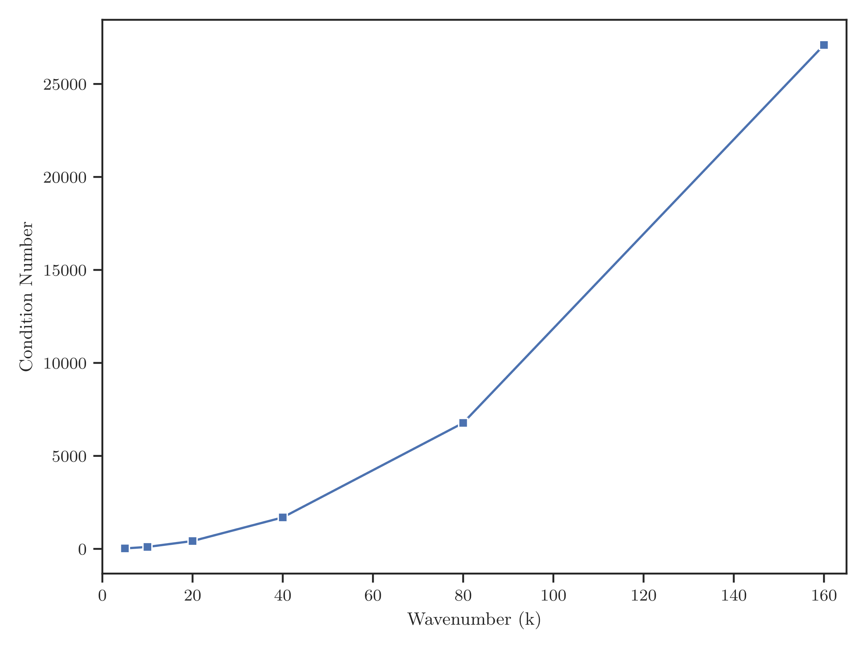

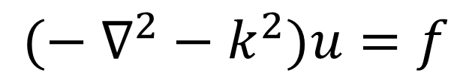
A Benchmark for Numerical Solvers: The Indefinite Helmholtz Equation
$$(− ∇^{2}−k^{2})u=f$$
The efficient numerical solution of this equation is a long-standing problem Ernst, O. G., & Gander, M. J. (2012). Why it is difficult to solve Helmholtz problems with classical iterative methods.
The resulting system $Ax=b$ becomes ill-conditioned for large values of the wavenumber $k$
Even small numerical inaccuracies lead to a huge increase in the approximation error

Slide 7
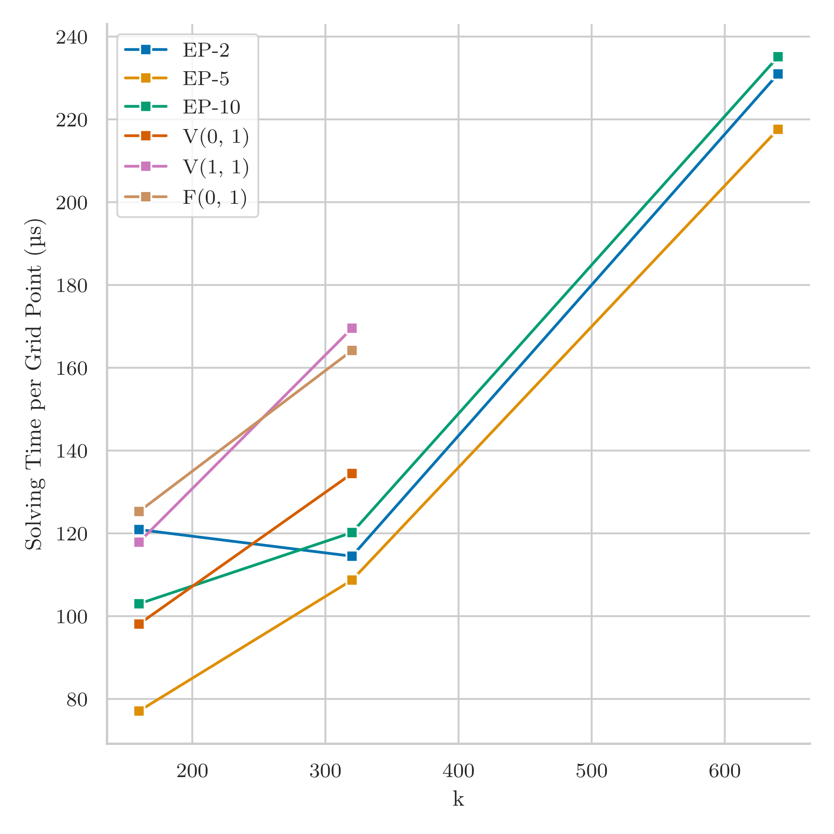

A Benchmark for Numerical Solvers: The Indefinite Helmholtz Equation
One of the most cited papers in this area
A functioning multigrid-based preconditioner was only discovered in 2006 by Erlangga et al. Erlangga, Y. A., et al. (2006). A novel multigrid based preconditioner for heterogeneous Helmholtz problems.
Our evolved solvers can handle highly ill-conditioned Helmholtz problems with more than a million unknowns
For the largest wavenumber ($k=640$) all known multigrid cycles fail to achieve convergence

Slide 8
Why our entry stands out

Slide 9
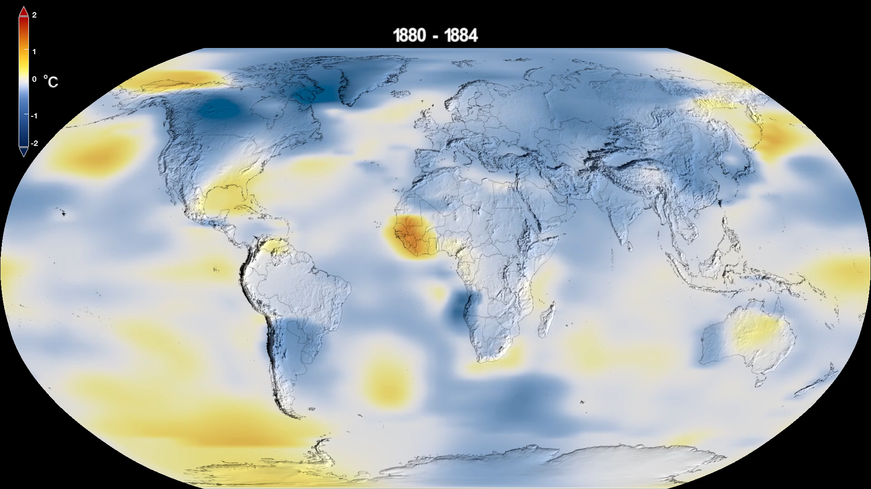
Why our entry stands out
Solving partial differential equations (PDEs) represents one of humanity’s greatest challenges
The difficulty of the problems we solve can be objectively judged based on their mathematical properties
Clear criteria for assessing the quality of our results:
Speed of solving
Generalization
NASA's Scientific Visualization Studio. Data provided by Robert B. Schmunk (NASA/GSFC GISS).

Slide 10



Why our entry stands out
Other AI-based approaches often yield fast solvers but struggle with generalization
We represent a solver in a symbolically-manipulable formal language
Generalization to other problem sizes without adapting the internal structure
Can be understood and analyzed by domain experts
→ Explainable AI
We scale evolution to recent clusters and supercomputers
Our implementation is freely available and open source
EvoStencils on GitHub

Slide 11
Thank you for your attention!
I also present the first paper of our entry in the GP 3 session at 15:20!

