Slide 1

Evaluating Medical Aesthetics Treatments through Evolved Age-Estimation Models Risto Miikkulainen^{1,2}, Elliot Meyerson¹, Xin Qiu¹, Ujjayant Sinha³, Raghav Kumar³, Karen Hofmann³, Yiyang Matt Yan⁴, Michael Ye⁴, Jingyuan Yang⁴, Damon Caiazza⁴, Stephanie Manson Brown⁴ ¹Cognizant AI Labs ²The University of Texas at Austin ³Cognizant Technology Solutions ⁴AbbVie, Inc.

Slide 2
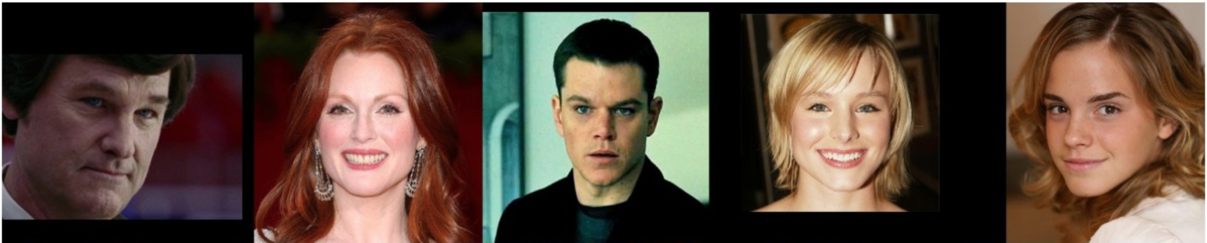
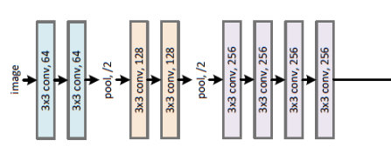
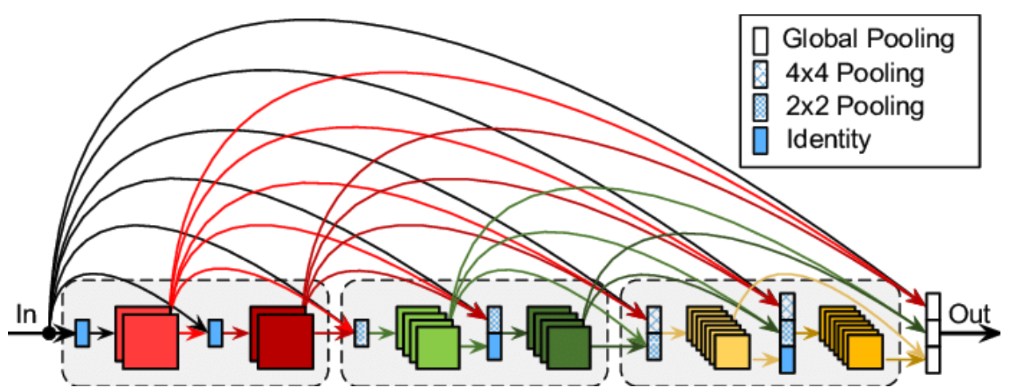
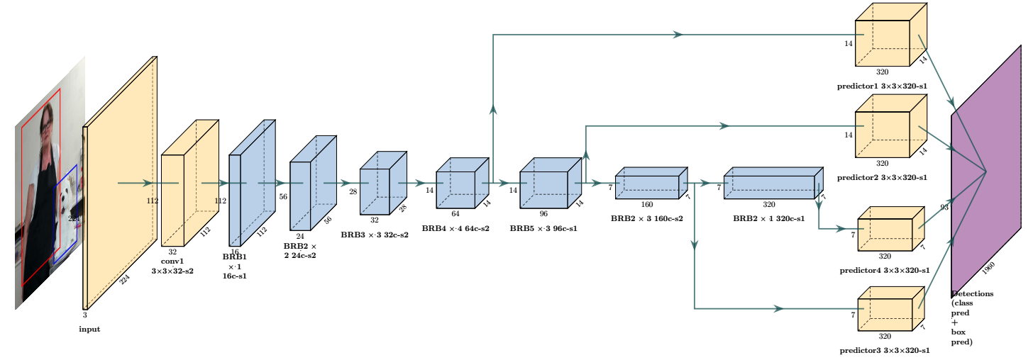
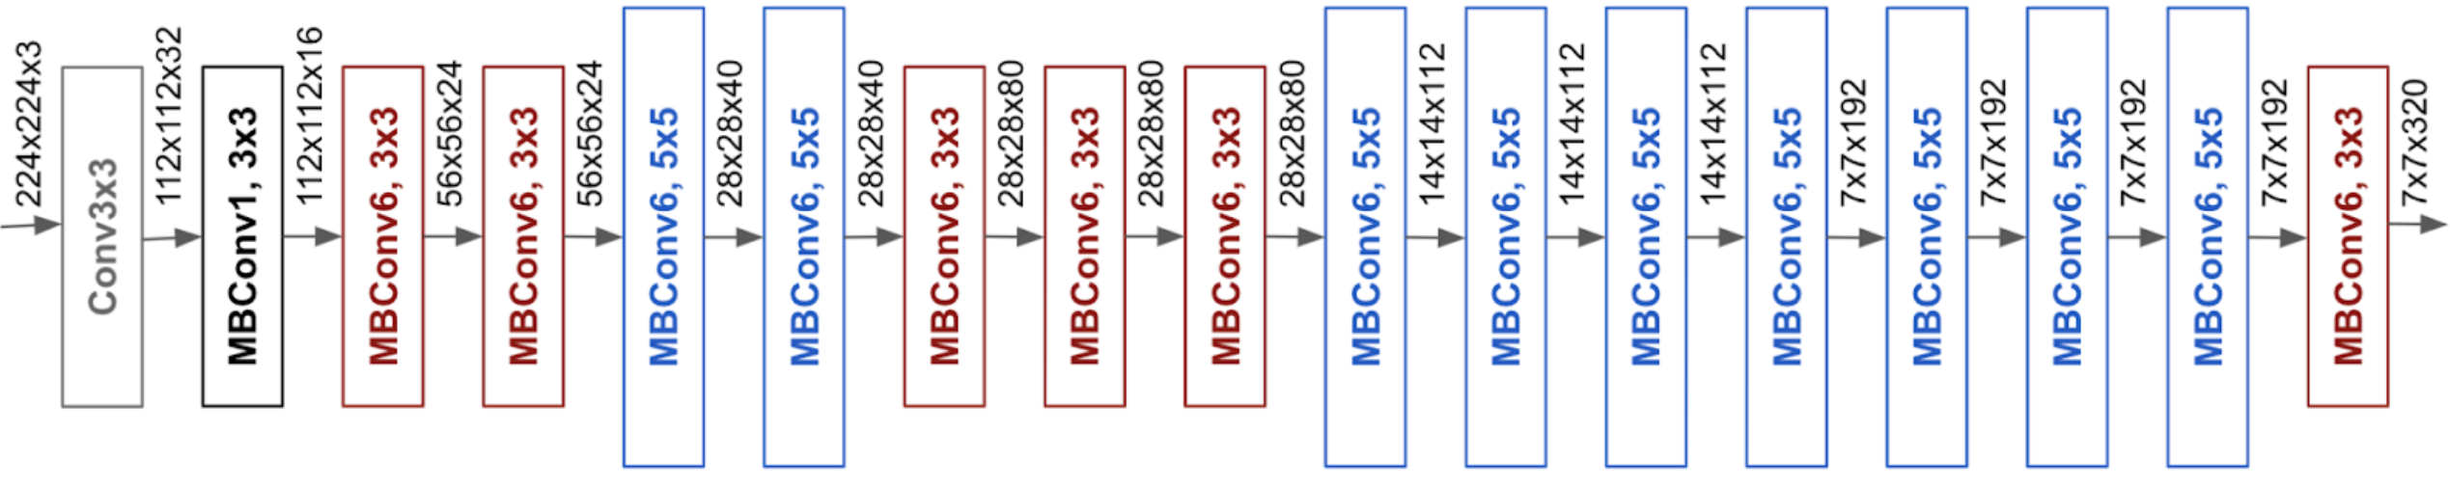
The Task: Estimating Age from Facial Images
Tsang 2018
Huang et al. 2017
Sanjay & Ahmadinia 2022
Tan & Le 2019
A challenging, useful task for deep learning (DL)
Challenging: Used as a benchmark for new DL designs since 2017
E.g. VGG, DenseNet, MobileNet, EfficientNet…
Useful: An actual application to improve lives
Evaluating effectiveness of medical aesthetics treatments
Goal: Demonstrate that evolution can design better networks than humans can

Slide 3
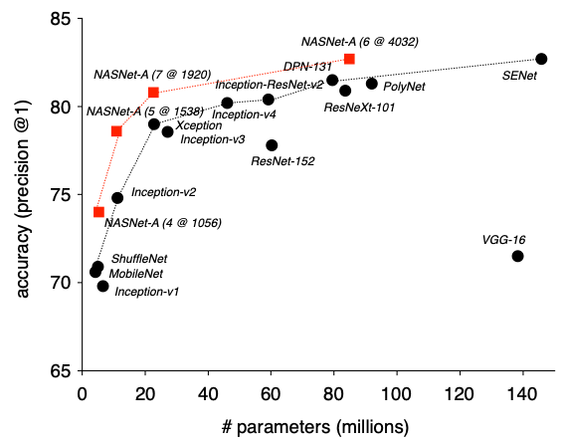
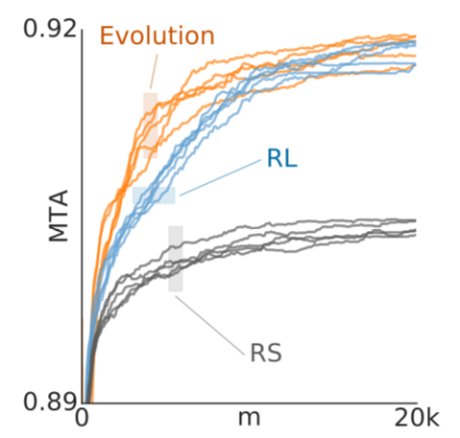
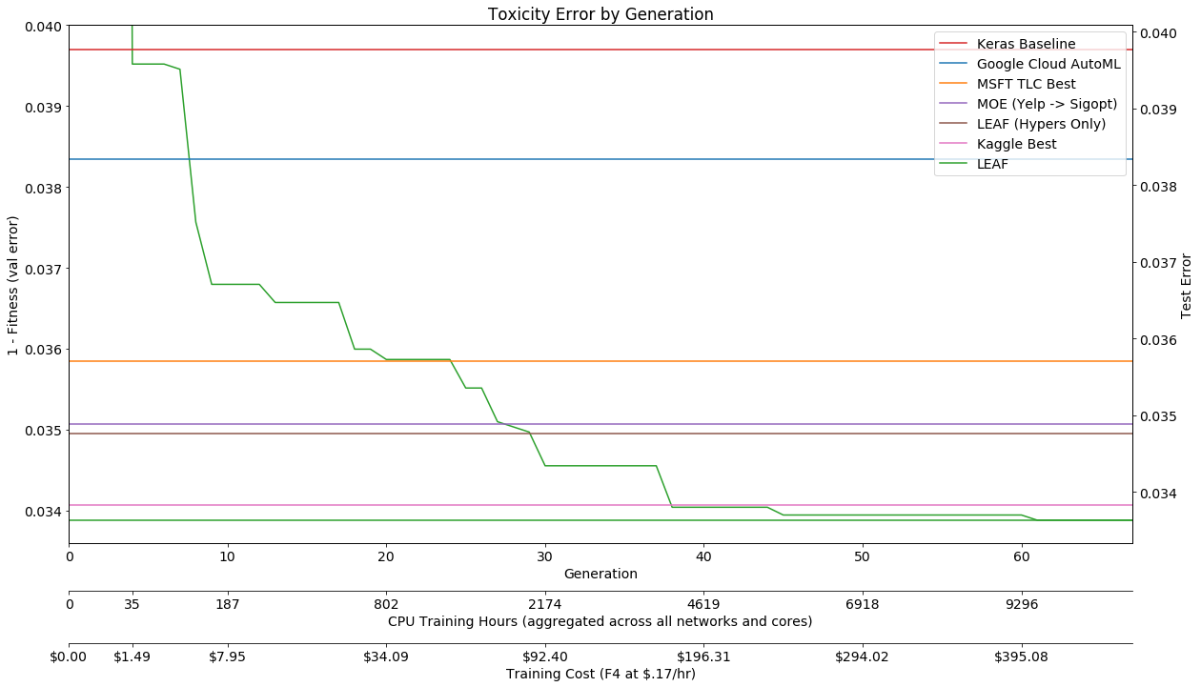
A Unique Human-Competitive Challenge
Zoph et al. 2018
Real et al. 2019
Liang et al. 2019
There are already many human-competitive metalearning results
This is different because it is a natural experiment
Abbvie evaluating whether neuroevolution is a worthy investment
A team of domain experts, data science experts already working on improving SotA
A professional, open, head-to-head, real-time competition
Funding; pride; defending AI against humanity (and vice versa)
Each side pushing the other to do better; sharing discoveries

Slide 4
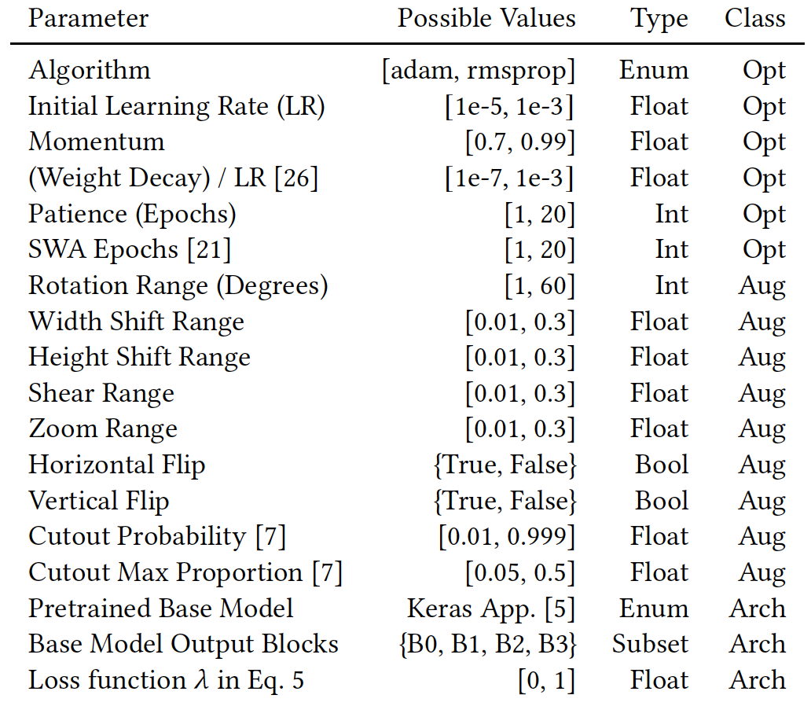
Hand-design and Neuroevolution Approaches
Starting point:
Latest literature on age estimation, DL, model optimization
Latest neuroevolution of DL designs
Evolutionary optimization:
Backprop, data augmentation, architecture hyperparameters
Population-based training:
20 epochs in each generation
Loss-function optimization
Ensembling of evolved solutions
Experiments run simultaneously
About the same effort and compute
(Method details are in the paper)

Slide 5
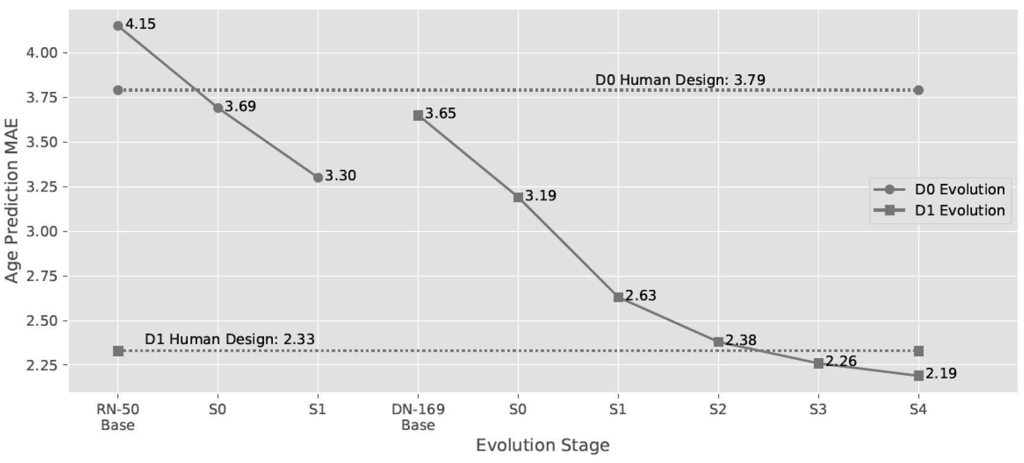
Evolution Beats Humans, and Not Just Once…
1. With the smaller, more homogeneous dataset D0:
Both starting from ResNet-50 with 4.15 MAE
Humans improved from to 3.79
Evolution improved to 3.69

Slide 6
…But Twice!
2. With the larger, more diverse dataset D1:
Scaling up through DenseNet-169 and -201 to EfficientNet-B6 (ImageNet SotA) increasing resolution, more epochs
Humans improved to 2.33
Evolution Improved to 2.19
New SotA; twice as accurate as human performance

Slide 7
Why Did It Work?
Evolution optimizes better than humans can
Many more parameters simultaneously
Evolution discovers principles that are not obvious even to experts
5x more vertical shift: Less overfitting to forehead and chin
Different losses at different stages: Less overfitting with MAE early
A prime example of evolution in action

Slide 8
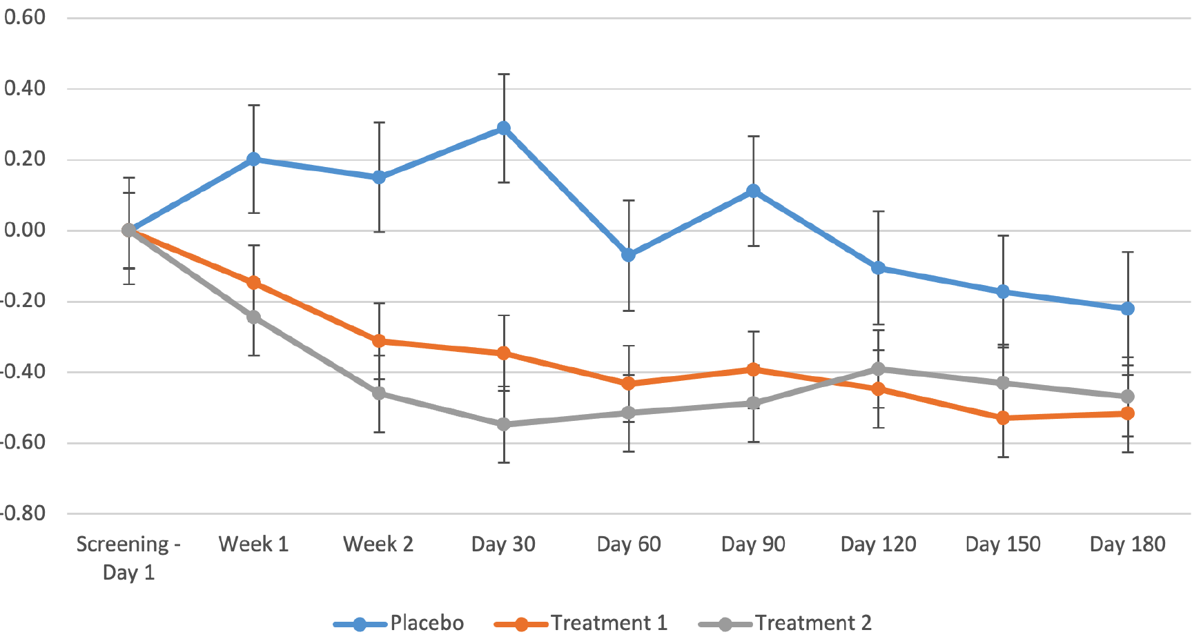
Does It Matter?
Previously, treatment evaluation was subjective
With the improved accuracy, can evaluate it quantitatively
Even a single injection is found to reduce perceived age significantly
Improvement over humans makes a new application possible

Slide 9
Why Is This Result the Best?
A head-to-head competition with humans
With both sides incentivized to beat the other
With a similar access to ideas, expertise, and resources
A real-world domain where that difference matters
Motivated by building a better application, not just as a benchmark

