Slide 1

TestFul:
Automatic Unit-Test Generation for Java Classes
Matteo Miraz, Pier Luca Lanzi
DEI – Politecnico di Milano (Italy)

Slide 2
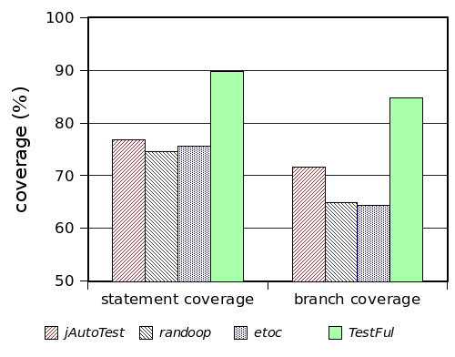
Automated Test Generation
Software systems permeate (almost) every aspect of our life
  Software is buggy
  In 2002 the costs related to software errors in the U.S. are estimated in 60 Billion USD
  An adequate testing campaign might require up to half of the software development effort
Several approaches to
automatically generate tests:
  Symbolic Execution
  Random Testing
  Evolutionary Testing

Slide 3
Our Approach: TestFul
Focuses on Java Classes
Features may be state-dependent
Fitness Function:
Designed to maximize the number of features exercised
Composed by Statement, Branch & DU pairs coverage
Efficiency Enhancements:
Local search to tackle difficult branches
Seeding to start from a better initial population
Fitness Inheritance to reduce the test execution costs

Slide 4
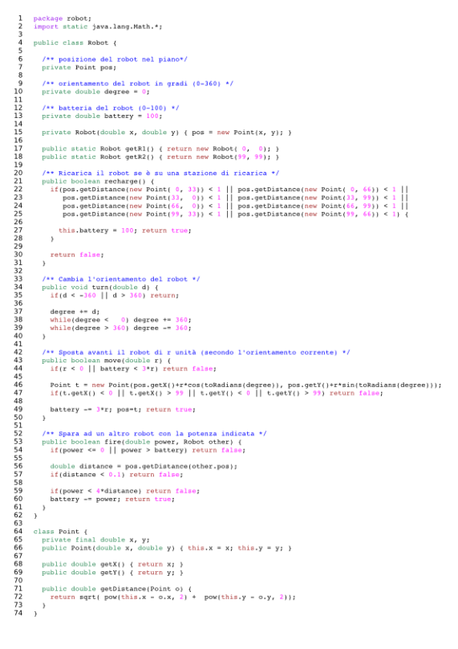
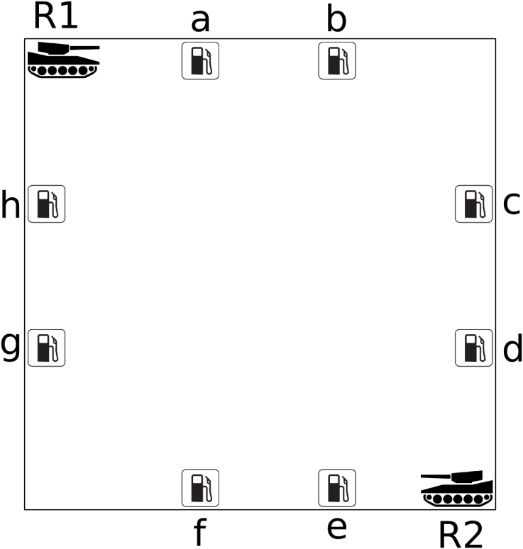
Design of the Experiment
We compare TestFul against test generated by our SE students
Software Engineering course, after lessons on Testing
Students were given 40 minutes to test a short, non-naive class
Notes:
The class used in the benchmark was composed by 75 Lines of code of Java, formatted to fit well in an A4 page. The class implements the logic to control two robots, which can move in a limited space, recharge the battery in 8 recharge stations, and fire to another robot.

Slide 5
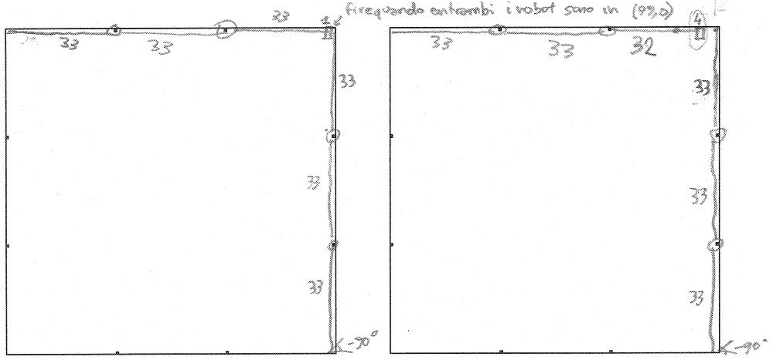
Design of the Experiment
We compare TestFul against test generated by our SE students
Software Engineering course, after lessons on Testing
Students were given 40 minutes to test a short, non-naive class
Students were facilitated in writing the tests
Notes:
The students were facilitated by allowing them to “draw” tests (that were faster than writing test code in Java).

Slide 6
Design of the Experiment
We compare TestFul against test generated by our SE students
Software Engineering course, after lessons on Testing
Students were given 40 minutes to test a short, non-naive class
Students were facilitated in writing the tests
Automated approaches run on the same class for 10 minutes
The comparison was made on the test quality
  Measured with mutation score
  We used the Mann–Whitney–Wilcoxon U statistical test
The experiment was inspired to:
S. Mouchawrab et. al., Assessing, Comparing, and Combining State Machine-Based Testing and Structural Testing: A Series of Experiments,
IEEE Transactions on Software Engineering, 2010

Slide 7
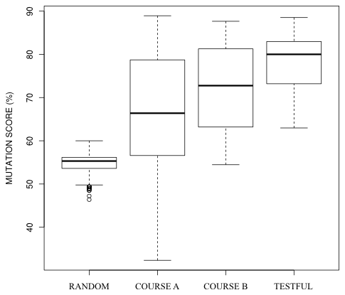
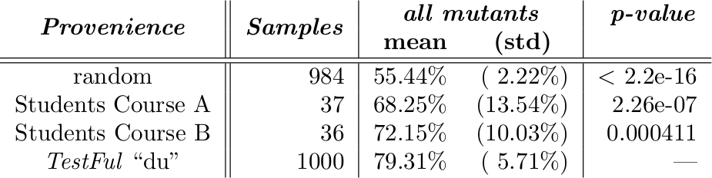
Empirical Results

Slide 8
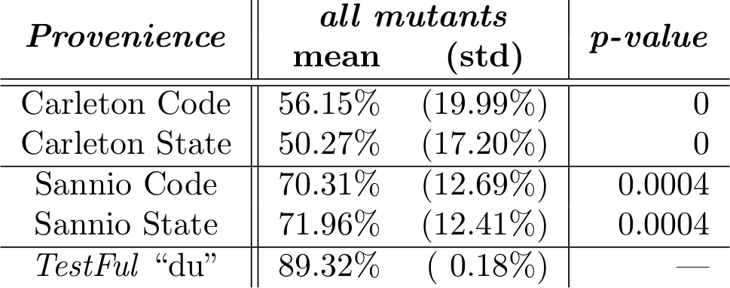
Empirical Results
Comparing to the Mouchawrab’s TSE

Slide 9

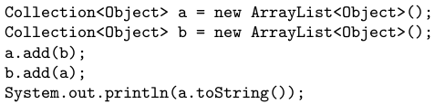
Empirical Results (2)
«container classes are the de facto benchmark
for testing software with internal state»
[ Arcuri 2010 ]
Bug #4275605

Slide 10
Why We Are Human Competitive
B) The result is equal to or better than a result that was accepted as a new scientific result […]
We compare TestFul with the TSE of Mouchawrab et. Al.
C) The result is equal to or better than a result that was placed into a database […]
  TestFul found a bug in the Java Collections Framework
H) The result holds its own or wins a regulated competition involving human contestants […]
  TestFul produces better results than human being
Reference: Matteo Miraz; 2010; Evolutionary Testing of Stateful Systems: a Holistic Approach; Ph.D. thesis; Politecnico di Milano

