Slide 1


Automatic Synthesis of Swarm Behavioural Rules from their Atomic Components
Dilini Samarasinghe, Erandi Lakshika, Michael Barlow, Kathryn Kasmarik
Humies @ GECCO 2018
School of Engineering and Information Technology
The University of New South Wales
Australia

Slide 2
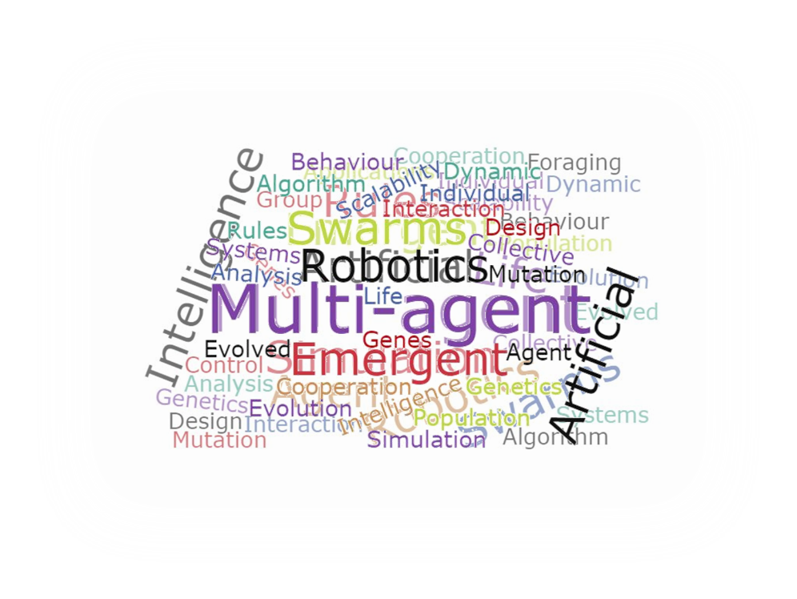

Are we there yet…?

Slide 3



Why?
Multi-agent systems adopt a bottom-up approach in modelling behaviours
  - Individual agents are codified with simpler rules which give rise to complex behaviours at the emergent level
Emergent Behaviour
“Behaviour that arises out of the interactions between parts of a system and which cannot easily be predicted or extrapolated from the behaviour of those individual parts.”
Codifying individual behaviours
Complex behaviour at emergent level

Slide 4
How difficult can it be?
Multiple design choices
  - Tuning multiple parameter values
  - Deciding appropriate combinations of rules and actions etc.
Complex and dynamic tasks cannot be precisely defined in advance
- Behaviour in emergency situations
- Complex ecosystems etc.
Human intuition is simply insufficient
- Capacity of comprehending individual agent behaviour that in interaction can give rise to desired swarm behaviours is simply limited

Slide 5

Manual coding of behavioural rules is limiting the potential of multi-agent models to achieve complex tasks in real world domains

Slide 6
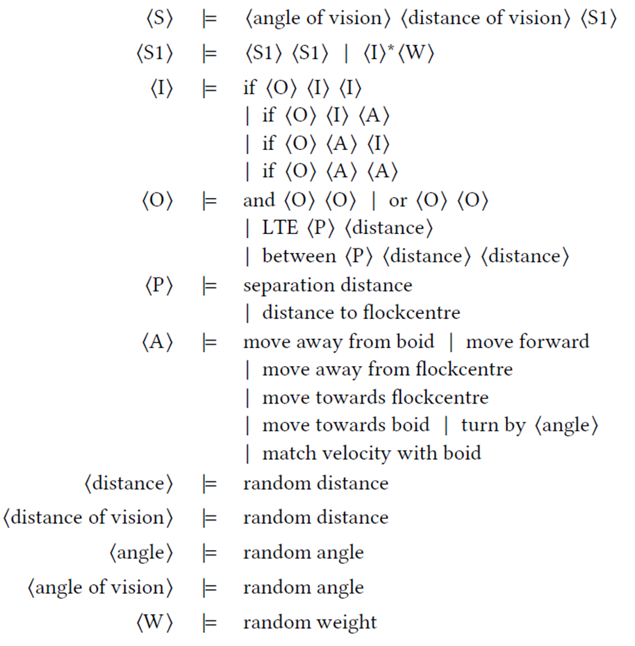
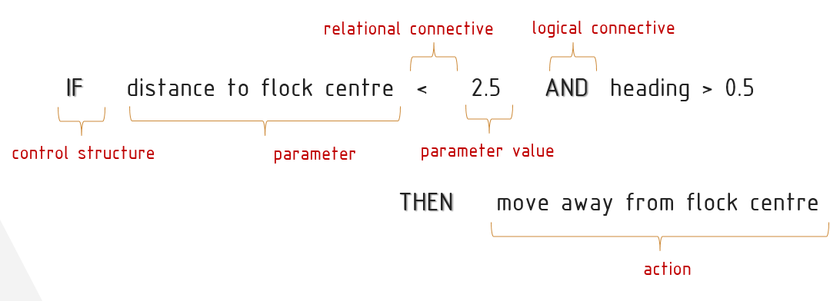
What do we propose?
A grammatical evolution based model that can automatically synthesise multi-agent behavioural rules from their most atomic components
  - The entire rule including the structure can be evolved from their atomic components based on a valid syntax unlike existing mechanisms where the rule structure is pre-defined
Components of a Rule
Proposed Grammar

Slide 7

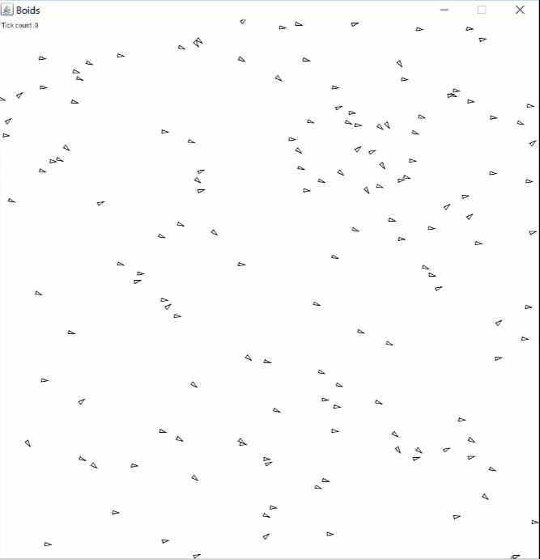
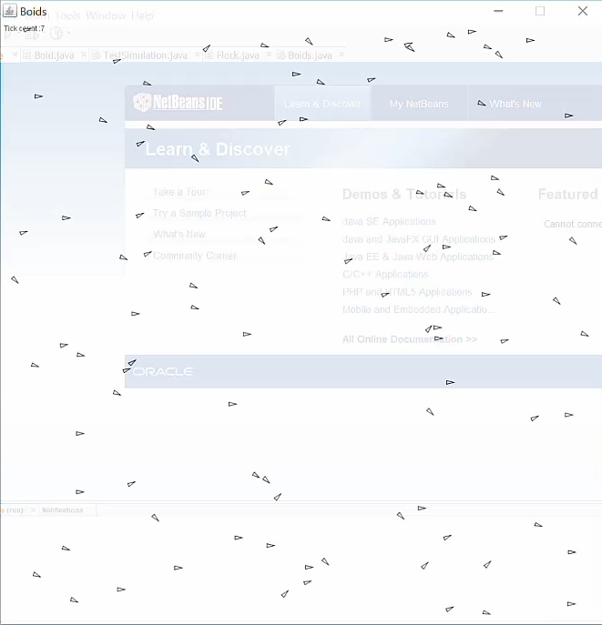
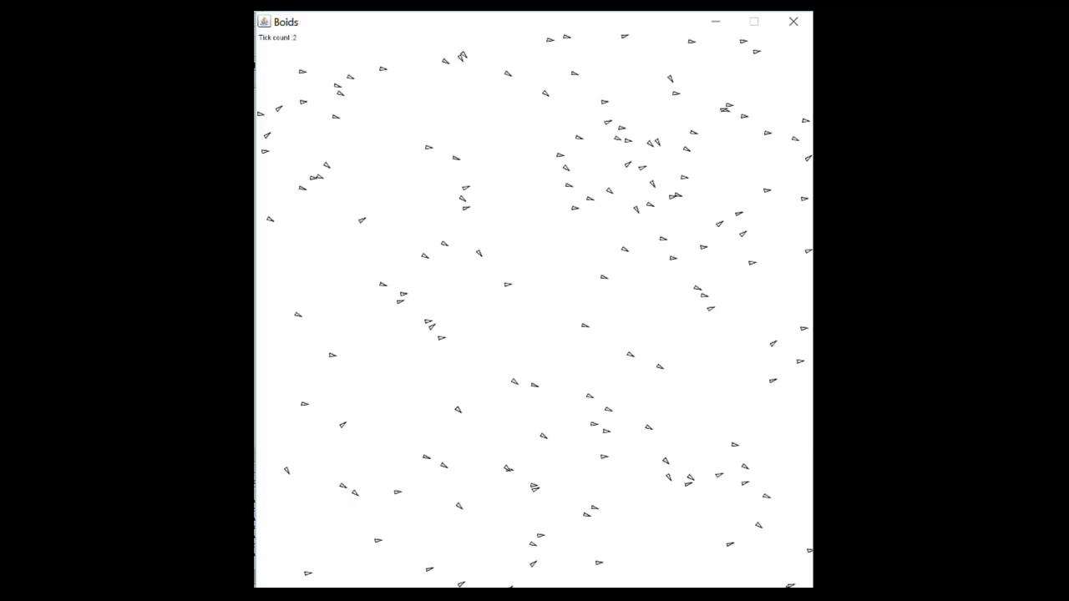
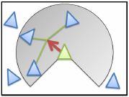
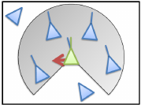
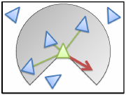
How is it human competitive?
Reynolds’ seminal simulation model based on bottom-up approach to achieve complex behaviour at the emergent level
  - Hand crafted 3 simple behaviours; cohesion, alignment and avoidance
  - A weighted combination of 3 rules give rise to flocking behaviour
We successfully evolved the hand crafted 3 behaviours as well as more complex flocking behaviour
- Using even more fundamental components of the rules in the proposed grammar
- With no manual designing involved
Cohesion
Alignment
Avoidance
Flocking

Slide 8
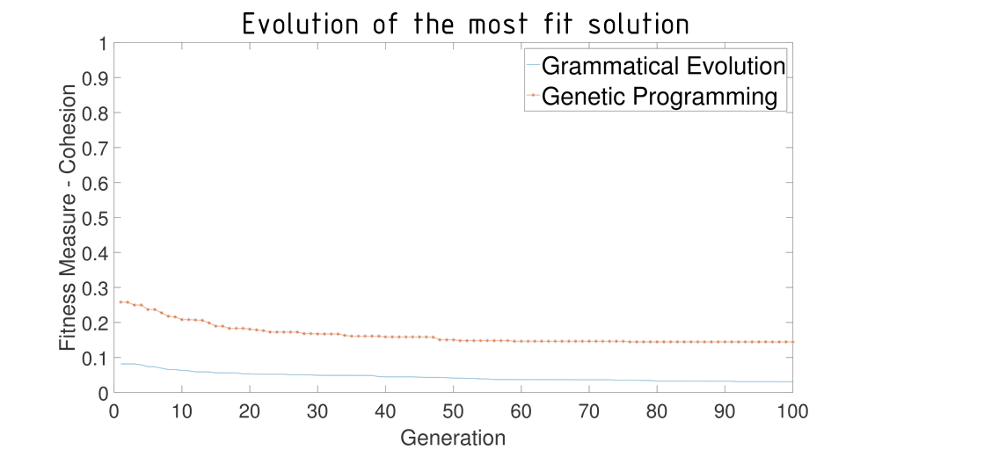
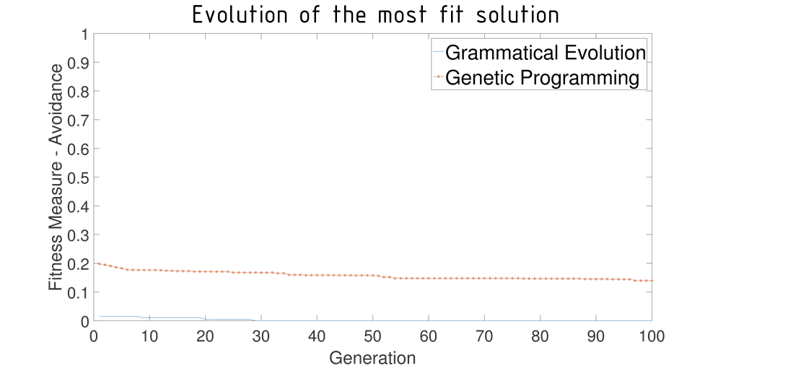
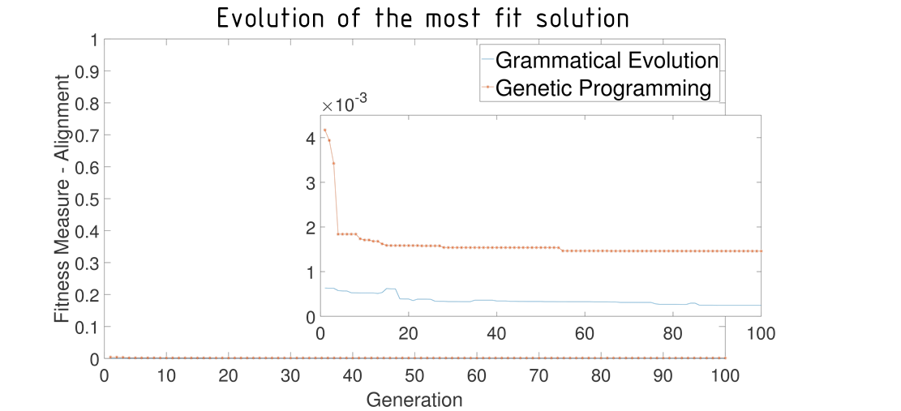
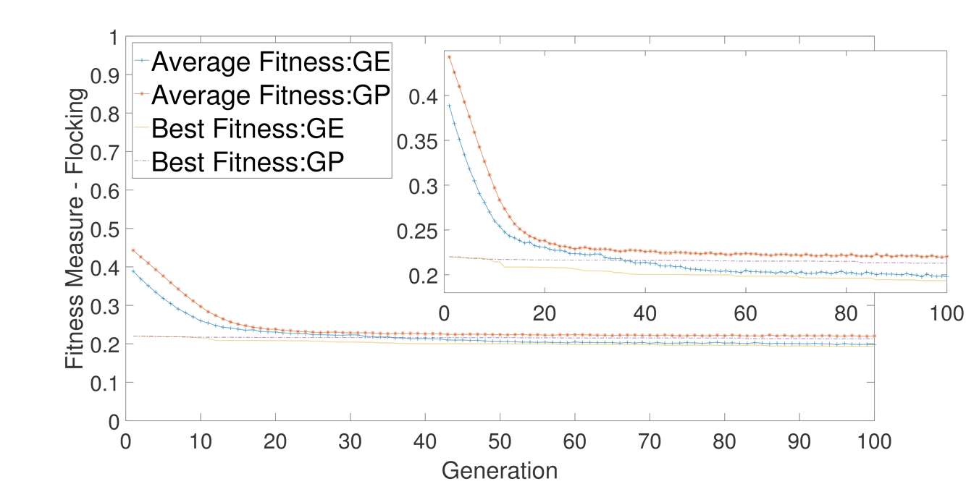
How is it human competitive?
A comparison against a genetic programming model demonstrated statistically better results for our model
- Genetic programming is the only other approach that can incorporate rule components and structure into the
evolutionary process
Cohesion
Avoidance
Alignment
Flocking

Slide 9
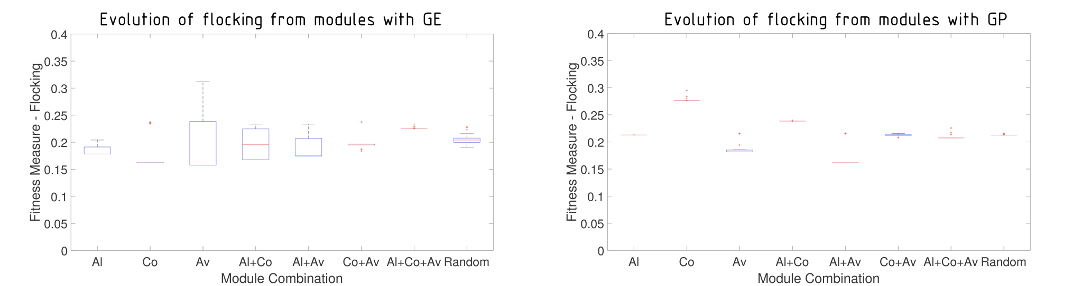
How is it human competitive?
Explored the potential of using a modularised approach to generate even more complex behavioural rules
- Rules evolved for the 3 simple behaviours were combined in different proportions to evolve flocking

Slide 10


Where do we surpass the competitors?
Reinforcement Learning
Global rewards are difficult
to be decomposed into individual rewards
Difficult to deal with complex
behaviours and numerous agents
Artificial Neural Networks
- Black-box framework and
difficult to reverse engineer and adopt manually
- Difficult to increase complexity of the behaviours due to restrictions of network size
Grammatical Evolution
Transcends human cognitive
limitations and bias
Can explore complex solution
spaces with no restrictions
- Generates completely transparent rules with reverse engineering capability
Genetic Programming
Restricted by closure property
Limited control over individual
structure and generates many invalid individuals during evolution
Genetic Algorithms
- Only address the problem of
manual tuning the parameters
- The rules still have to be designed manually

Slide 11
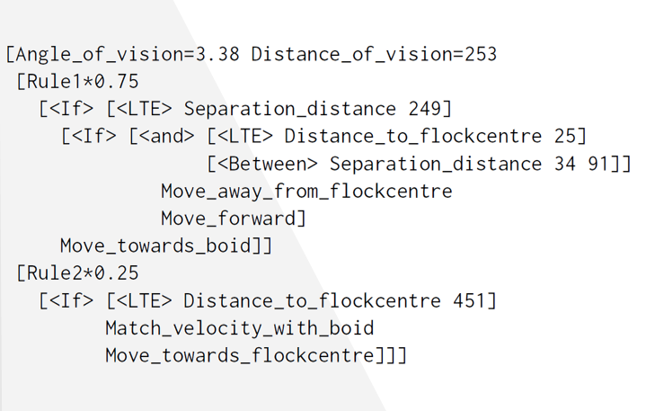
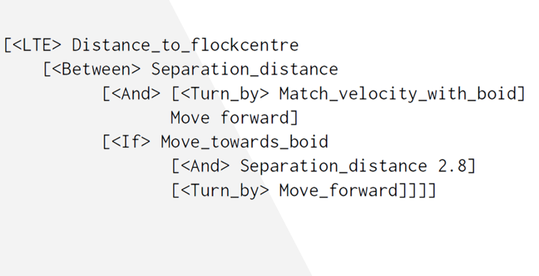
Where do we surpass the competitors?
Our model allows complete transparency and reverse engineering capability with the generated rules which is not possible with other evolutionary approaches
A Rule Evolved with Grammatical Evolution Model
A Rule Evolved with
Genetic Programming Model

Slide 12
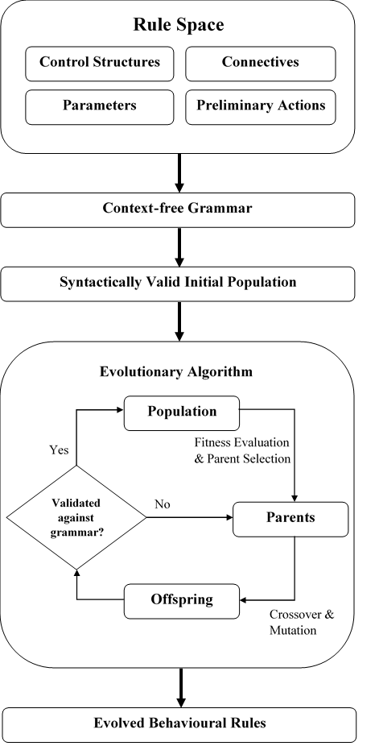
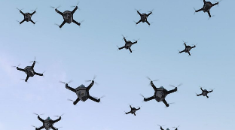
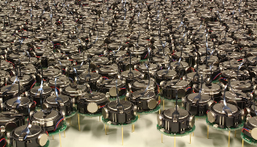
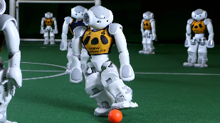
Where do we surpass the competitors?
Our model is generalisable to any multi-agent domain

Slide 13
Criteria we satisfy
Address human bias and cognitive limitations in multi-agent behavioural rule generation
(G) The result solves a problem of indisputable difficulty in its field
First to incorporate atomic components of rules into an automatic synthesis mechanism using grammatical evolution
  (D) The result is publishable in its own right as a new scientific result independent of the fact that the result was mechanically created
Automatically synthesised realistic behaviours for Reynolds’ three boid rules which he hand crafted, and also for flocking behaviour using the same grammar
  (F) The result is equal to or better than a result that was considered an achievement in its field at the time it was first discovered, ‘and won its designer an Academy Award’
Results compared against a genetic programming model which is the only other approach that can incorporate rule structures in evolution demonstrated that our model generates statistically better results
  (E) The result is equal to or better than the most recent human-created solution to a long-standing problem for which there has been a succession of increasingly better human-created solutions

Slide 14




How does our work stand out?
Generalisability of the approach
- Ability to be used in any multi-agent domain
Potential of the solution
- Minimises impact of human bias and limitations of human cognitive capacity
- Complete transparency over evolved rules to understand agents’ current actions and plans, reasoning process and outcome predictions
Significance of the problem
- Human cognitive capacity and bias limits exploring full potential of multi-agent systms
- Series of solutions involving numerous approaches with limited success
Influence on future research
- Exploring the modularised approach with different modularity and hierarchical techniques to evolve behaviours of heterogeneous agent communities
- Enhancing the rule space to incorporate more components to generate more complex behaviours

Slide 15

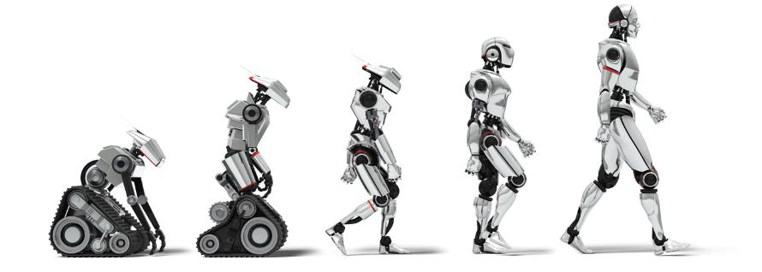
A step forward towards the development of highly sophisticated robot groups and swarms for the future

Slide 16
Automatic Synthesis of Swarm Behavioural Rules from their Atomic Components
Dilini Samarasinghe, Erandi Lakshika, Michael Barlow, Kathryn Kasmarik
Humies @ GECCO 2018
School of Engineering and Information Technology
The University of New South Wales
Australia

Slide 17
Image Sources
https://thumbs.dreamstime.com/b/robots-moving-shipping-boxes-14497090.jpg
https://d1o50x50snmhul.cloudfront.net/wp-content/uploads/2018/01/10162242/gettyimages-638714594-800x533.jpg
https://commons.wikimedia.org/wiki/File:Kilobot_robot_swarm.JPG
https://edge.alluremedia.com.au/m/g/2017/07/Robocup.jpg
https://peoples-free.com/highresolution/590-free-peoples.png
https://motivacionydeporte.files.wordpress.com/2013/01/idea.jpg?w=1400
https://steemitimages.com/0x0/https://img.esteem.ws/36aacgud3j.jpg
https://covnetpres.org/wp-content/uploads/sites/16/2018/06/seats-at-table.jpg
https://cdn-images-1.medium.com/max/1100/1*tXAP1N7i73Y5wlEN0NoMew.jpeg

