Slide 1
Expert Competitive Traffic Light Optimization with Evolutionary Algorithms Human Competitive Awards @ GECCO July, 15th 2019, Prague
Yann SEMET – Thales Research & Technology
B. Berthelot, T. Glais, C. Isbérie, A. Varest

Slide 2
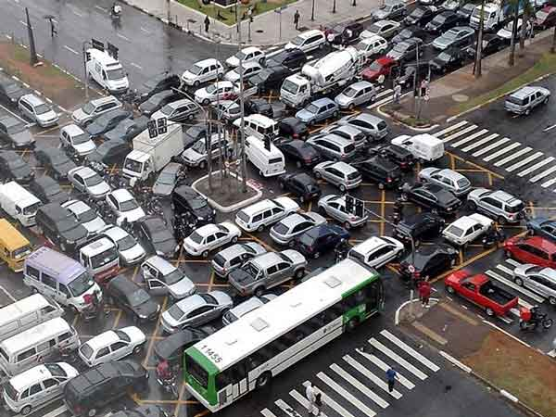
Context
Cost of congestion in the US alone in 2017: 305 billion dollars! (source INRIX, 2018)
Vehicle related pollution causes respiratory conditions, cancer, birth defects, clinical depression

Slide 3
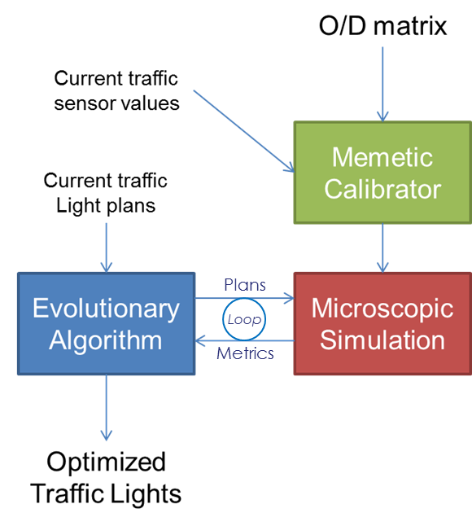

Context
Traffic studies are extremely time consuming & expensive, agility & sustainability needed
A Thales business unit sells monitoring & control system for urban traffic
They can act on traffic and have experts but these experts need help: too many parameters, too many objectives, too many difficult decisions
Our answer: multi-objective evolutionary computation + calibrated microscopic simulation (SUMO)
Optimizes traffic lights on demand, on the fly reducing:
Traffic jams (waiting time, # of processed vehicles, timeloss, etc.)
Pollutant emissions: CO, CO2, NOx, HC, PMx
Noise
Fuel Consumption
Human-Competitive Baseline: existing, human engineered, traffic light plans

Slide 4
Human-Competitive Criteria A&D: Patentability and Publishability
2 Patents in progress, both on ways to automatically produce traffic data objects of interest with supporting human-competitive experimental evidence:
Title: Decision Tree Optimization for Urban Traffic Regulation, Targeted Countries: France & the rest of Europe
Status: Validated by internal Thales Intellectual Property Protection jury, French patent office filing targeted for summer 2019
Title: Algorithmic Processing Chain for Urban Traffic Macro-Regulation, Targeted Countries: France & the rest of Europe
Status: Validated by internal Thales Intellectual Property Protection jury, French patent office filing targeted for summer 2019
Our reference paper was published in the Traffic Science community
VEHITS: double blind peer-reviewed International Conference on Vehicle Technology and Intelligent Traffic Systems, Heraklion, Greece, May 3-5 2019, no direct link to Artificial Intelligence or Optimization
Our contribution is unique in the state-of-the art: no other study is both as efficient and comprehensive (real-world data + classification + rigorous calibration + multi-objective + statistical validation + adaptive traffic lights) and none offers direct, fully documented, same conditions expert vs. algorithm comparison
Short-listed for inclusion, as a 25 pages extended version in a Springer book due summer 2019
What they are interested in is the result and its traits, not the producing algorithm

Slide 5
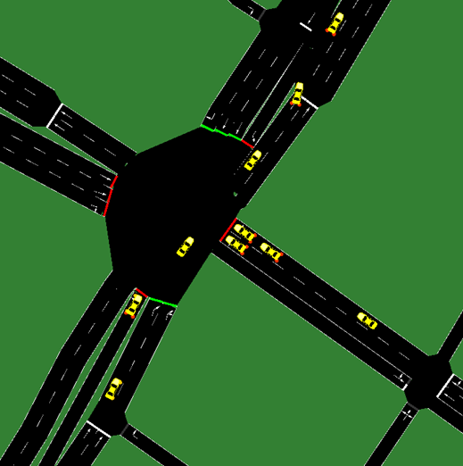
Criteria A&D: Reverse Engineering on the Result Yields Valuable Insight
An interesting byproduct of optimization: analyzing building blocks of good solutions
1 example ([N/S TL E/W]):
Initial plan: [29 12 21]
Optimized plan : [20 5 20]
Observations: phases 1 and 2 are under capacity, phase 3 is over capacity
1 key lesson:
Green time loss reduction (on under capacity phases) is primarily important, more so than green time reinforcement (on over capacity phases)
Improves expert methodology!

Slide 6
Criterion G: Undisputable Difficulty
Notorious urban planning problem, has been defeating decision-makers for decades
Traffic Science is an academic field of its own with dedicated laboratories, conferences and journals, there’s even a dedicated Traffic Signal Practitioners Symposium (Sept 2019, Nottingham, UK)
Traffic studies are extremely costly (highly qualified staff needed for long durations)
Evolving context and varying requirements
(Very) strong underlying mathematical difficulty, maddening for the expert in charge:
Highly Multi-Modal
Chaotic
Epistatic
Highly non-separable
Our systems successfully solves the problem and produces, on a carefully calibrated basis, statistically validated gains ranging from 15 to 35% on static plans in all objectives with respect to the human engineered baseline and up to 56% on adaptive plans

Slide 7
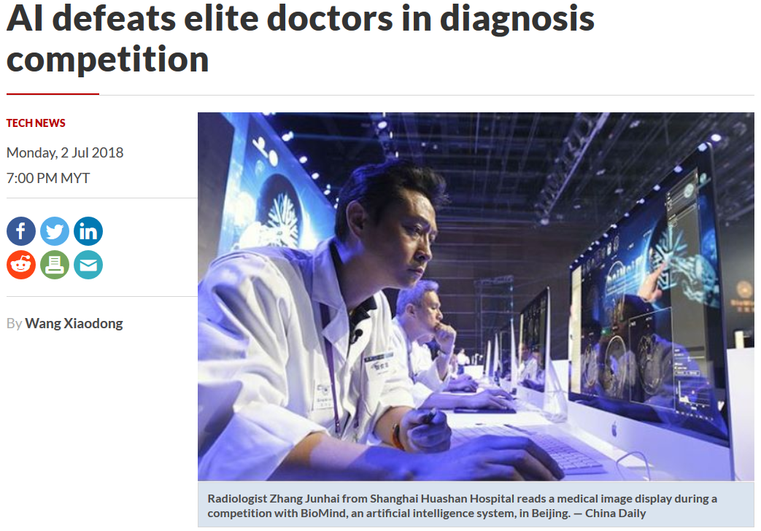

Criterion H: Genetic Algorithms versus Experts
Growing trend in AI: opposing experts and algorithms in fair, realistic conditions
Strong media impact
Very powerful and convincing way to prove value and build trust
Our rationale: see if we can bring that power to the Intelligent Traffic Systems community

Slide 8
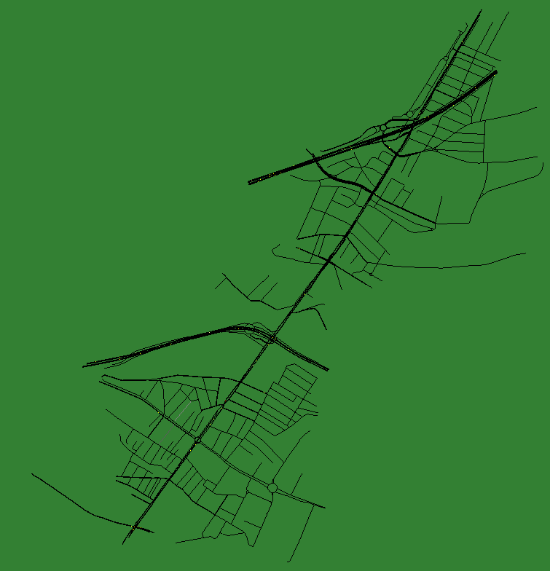
Criterion H: Experimental Setup
Comparison workshop happens in standard conditions (engineering office premises, with their own computer, closed doors, unlimited time)
Experts are asked to :
Make their methodology explicit and write it up beforehand (separate preliminary step)
Can use any (non AI) tool or heuristic they want
Can make as many trials as they need
Trace each of their steps and successive attempts with corresponding gain
Algorithm in run in parallel (hidden) on the exact same test zone on a standard laptop without parallel computing.
The exercise stops when the experts give up and cannot do any better.
Test zone, Northern Suburbs of Paris

Slide 9
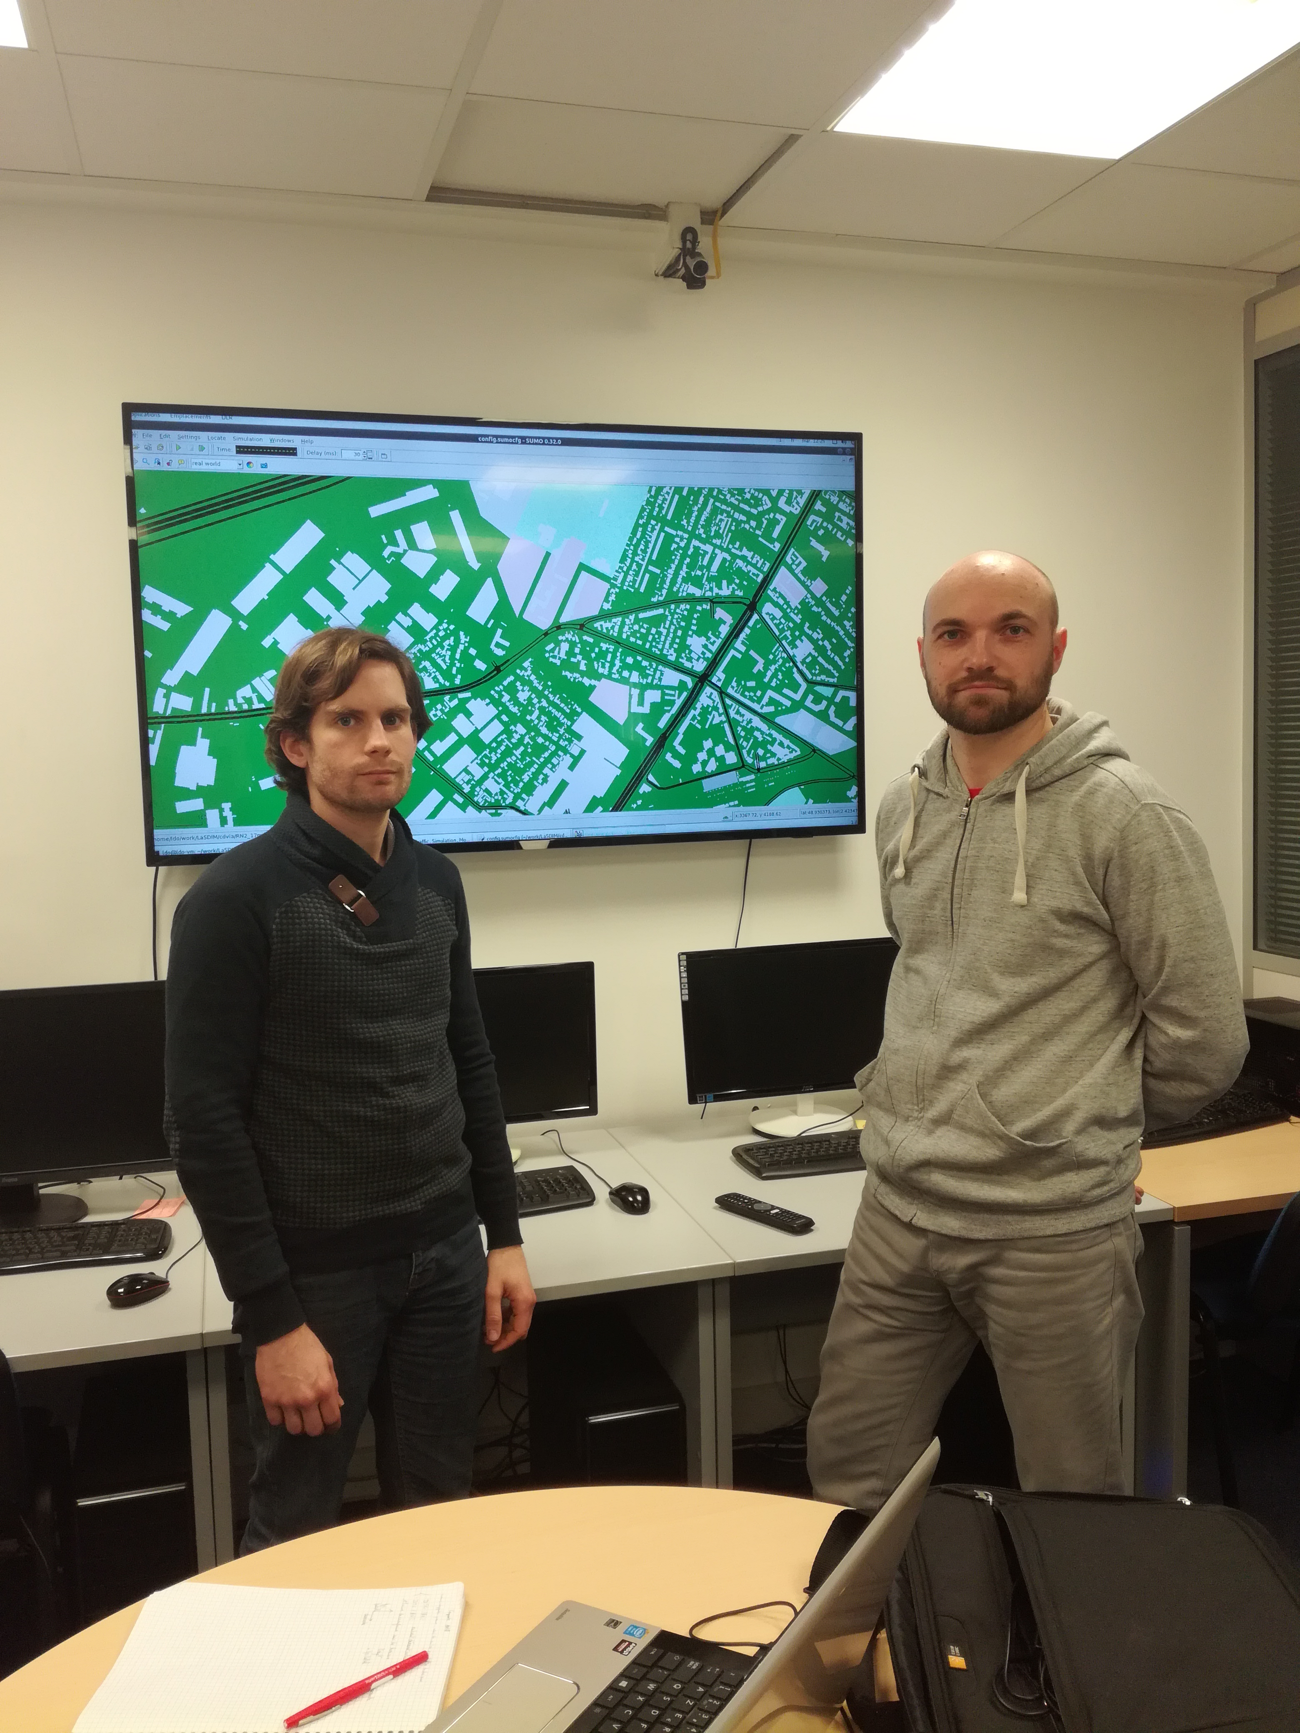
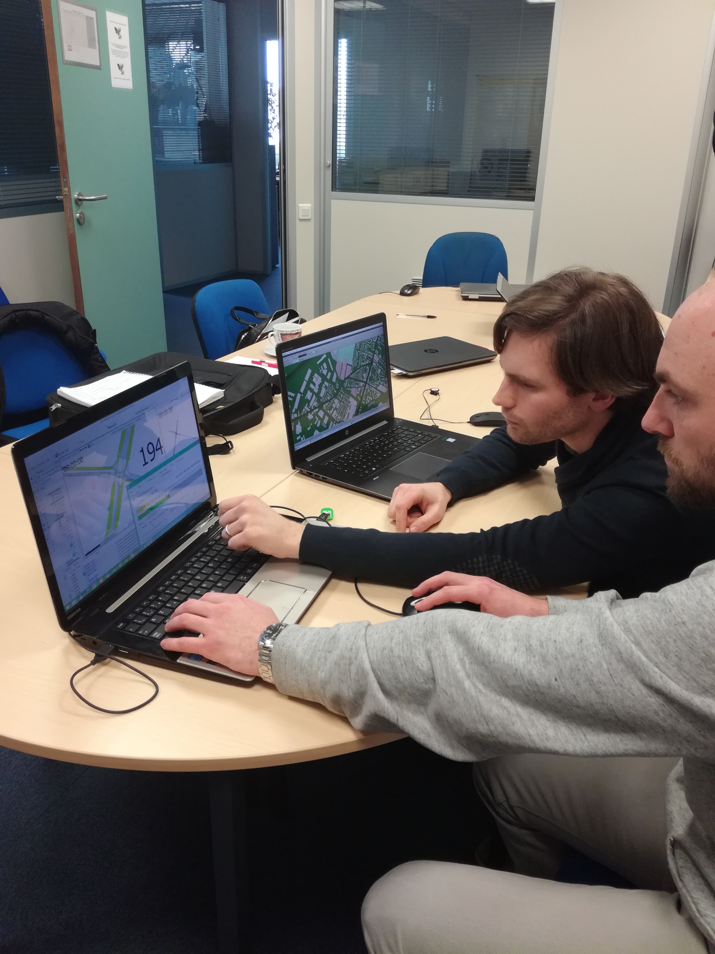
Criterion H: Meet the Experts!
Three experts from CDVIA, a Paris-based traffic engineering office:
Christian, M. Eng., 35+ years of experience, founder of the traffic engineering office, traffic regulation expert
Benoit (right) M. Eng., 10 years of experience, project manager
Aurélien (left), M. Eng, M. Sc, 5 years of experience, urban planning, regulation and simulation expert

Slide 10
Criterion H: Transcribed Expert Methodology
Rationale: formalizing, to some extent, a usually implicit, intuitive albeit experience-based process to produce a traceable reference to improve upon
Hypotheses: traffic conditions fixed, fixed plan structure, static plans, only modify green phases durations and temporal offsets
Methodology outline (further details in the paper):
Global static analysis (flows vs capacities)
Cycle length optimization
Green split optimization
Temporal offsets coordination (green waves)
Iterate as needed

Slide 11
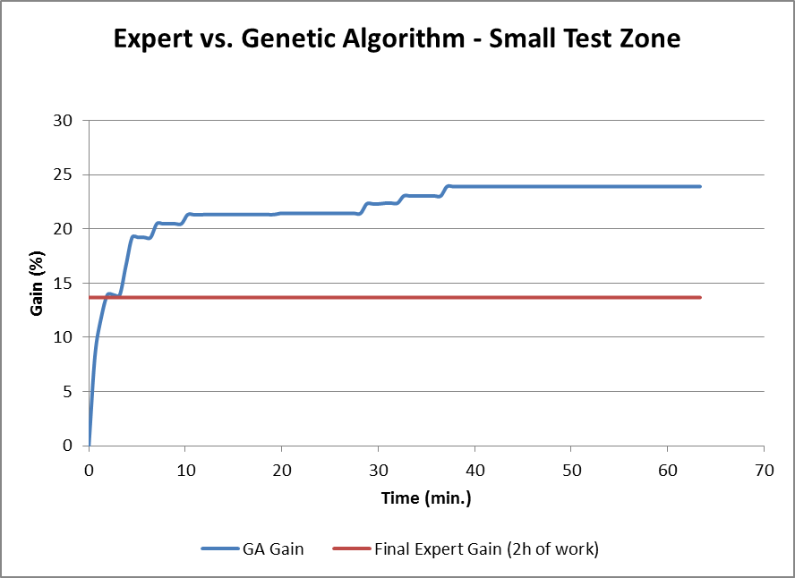
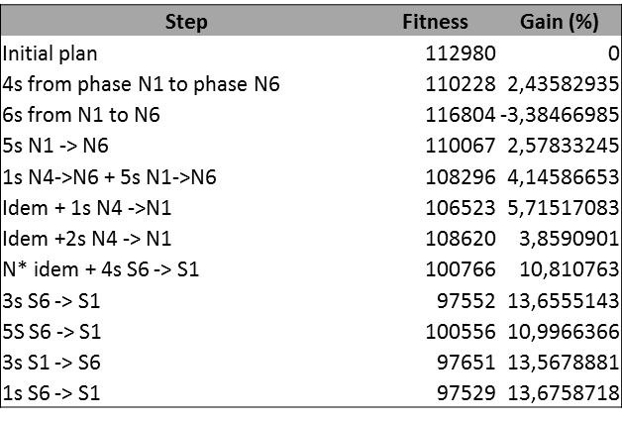
Criterion H: Results on the First Test Zone
Expert optimization log
EA: 23.9%
37 mins
Experts:13.68%
2 hours
Crossing point : 2 minutes

Slide 12
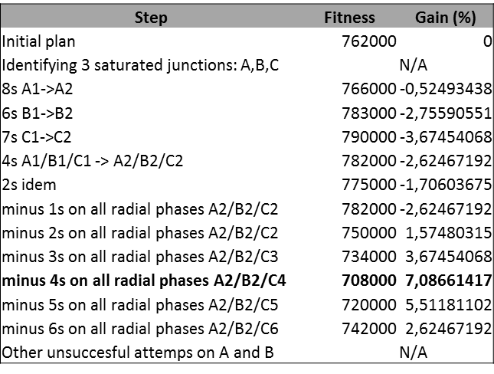
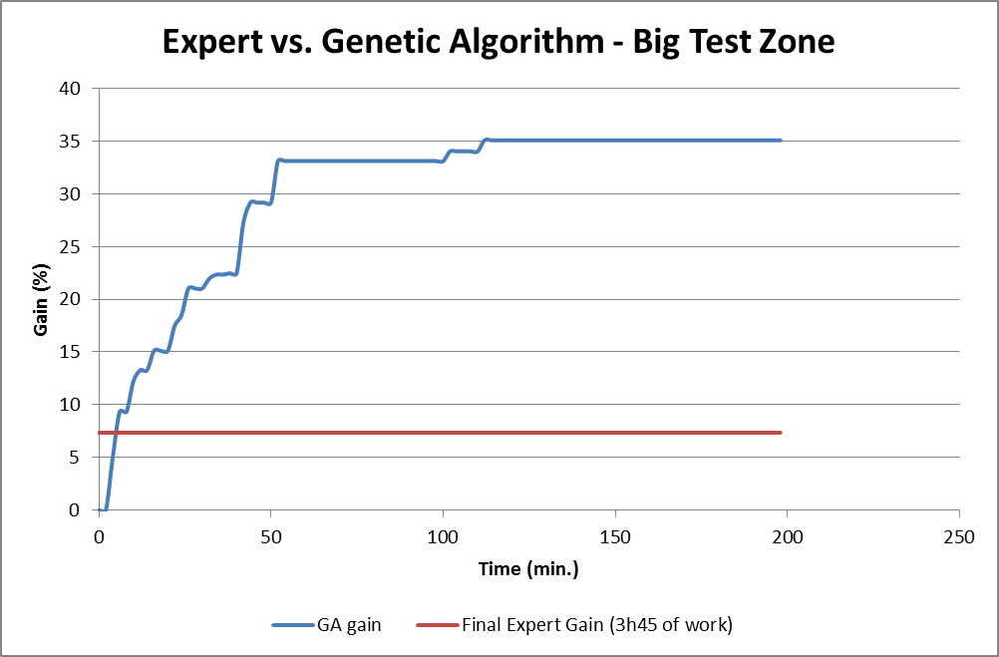
Criterion H: Experts vs Algorithms on the Large Test Zone
Expert optimization log
EA: 35.06%
1h42 mins
Experts:7.02%
3h45
Crossing point : 6 minutes

Slide 13
« Best » Statement
Significant societal problem for both health and cost, billions of dollars at stake (Inrix Global Traffic Scorecard Study, 2018)
Difficult problem (highly unstable, numerous subtle combinatorial dependencies, treacherous search landscape)
Comprehensive approach (calibration particularly)
Several flavors of human-competitive results:
Optimized Traffic identification vs. Expert Heuristics
Optimized Static Plans vs. Existing Baseline Plans
Optimized Adaptive Plans vs. Expert Set Adaptive Plans
Competition with actual experts in the exact same conditions:
Traced methodology & its application logs
Published in the traffic science community
Actual experts agreed to testify that on a real-world case, they are largely outperformed by the Evolutionary Algorithm in both speed (x30) and final solution quality (x5)!

