Slide 1
Behavior based User Authentication on Smart Phones
GECCO HUMIES - 2009
Muhammad Shahzad¹, Saira Zahid¹, Syed Ali Khayam^{1,2},
Muddassar Farooq¹
¹ Next Generation Intelligent Networks Research Center
National University of Computer & Emerging Sciences
Islamabad, Pakistan
http://www.nexginrc.org
² School of Electrical Engineering & Computer Sciences
National University of Sciences & Technology
Islamabad, Pakistan
http://wisnet.seecs.edu.pk

Slide 2
Citations
Muhammad Shahzad, Saira Zahid, Muddassar Farooq, "A Hybrid GA-PSO Fuzzy System for User Identification on Smart Phones", Genetic and Evolutionary Computation Conference (GECCO), July, 2009, Montréal, Canada. (In Press)
Saira Zahid, Muhammad Shahzad, Syed Ali Khayam, Muddassar Farooq, "Keystroke-based User Identification on Smart Phones", 12th International Symposium on Recent Advances in Intrusion Detection (RAID), Sept, 2009, Brittany, France. (In Press)

Slide 3
Smart Phones Market
BCC Research group published a 149 page report : “Global Market for Smart Phones and PDAs” in May 2009. Its digital copy costs $4850
2008: Global market of Smart Phones generated $58.7 billion
2013: expected to increase to $153.3 billion

Slide 4
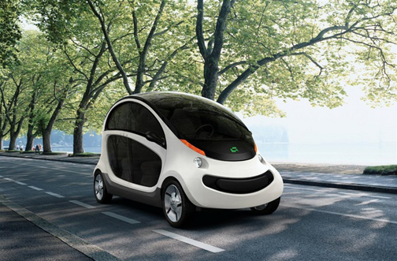

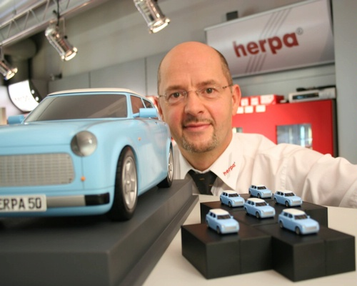
User Identification on Smart Phones: A Hot Issue
Mobile computing devices combine three extremely potent concepts
  computing
  mobility
  miniaturization
Information Security on mobile phones is a serious concern of both users and manufacturers
Red herring mobiles scream for help: UK-based mobile security company adds security to mobile phones, October 2006.
Ernst and Young Global Information Security Survey 2005 : Report on the Widening Gap

Slide 5
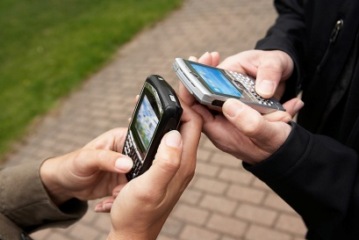
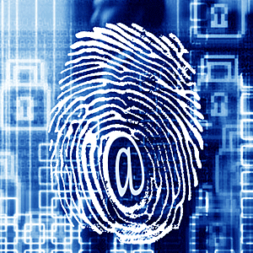

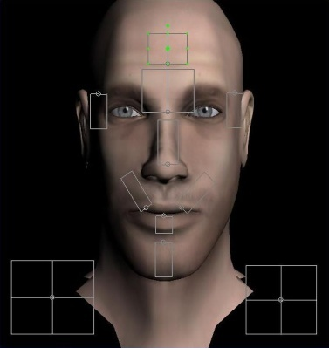
Its in your Hands, like its in your Eyes and Face
It is believed that keystrokes of people are distinct from each other just like their faces, finger prints, and eyes
Doesn’t require any extra hardware for identification

Slide 6
Keystrokes based Analysis: A long sought solution
A lot of research effort was focused towards keystroke-based user identification in 80s, 90s, and the current decade
Most of the work has been done in desktop domain
In 80s
Umphress and Williams 1985 6% FAR
Legget and Williams 1988 5% FAR
In 90s
Bleha, Slivinsky, and Hussein 1990 8.1% FRR, 2.8% FAR
Joyce and Gupta 1990 16.67% FRR, 0.25% FAR
Legget and Williams 1991 11.1% FRR, 12.8% FAR
Obaidat and Sadoun 1999
Recently Clarke and Furnell in 2007, worked on Mobile Phones 18%FAR, 29% FRR

Slide 7
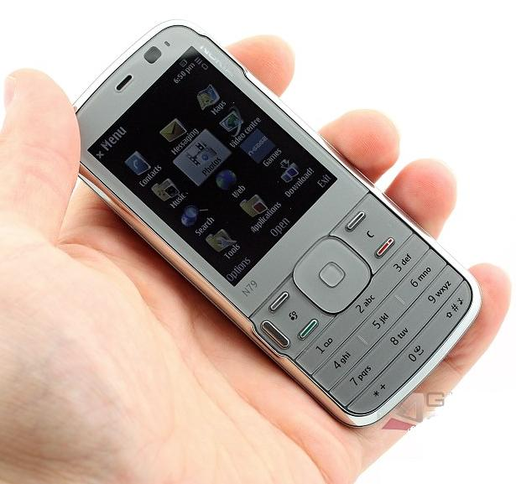
Keystrokes based Analysis: A long sought solution
The accuracy of existing solutions is quite far from acceptable
We tested the schemes of earlier researchers on mobile dataset
Provided abysmal accuracy: Even the best had 30% errors in our dynamic uncontrolled environment
All the work done till now has been in static controlled environments and the best results had 5% error rate
Multiplexed Keypads

Slide 8
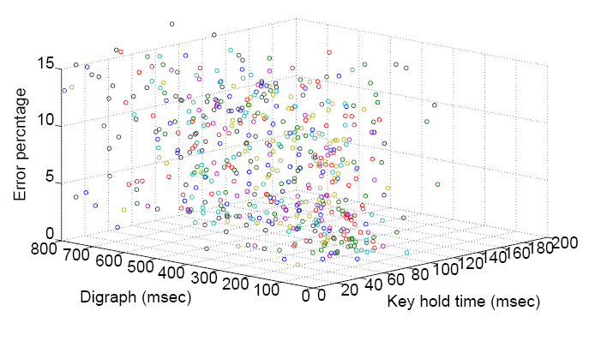
A Problem of Bio-inspired Classification
No one realized that this is a problem of bio-inspired classifier
Every one was using machine learning classifiers
Once we realized that conventional classifiers are not working, we decided to go unconventional
We designed a novel bio-inspired classifier and the improvement in results was not incremental: the accuracy improved dramatically
Diffusion in the dataset was handled using Fuzzy Logic

Slide 9

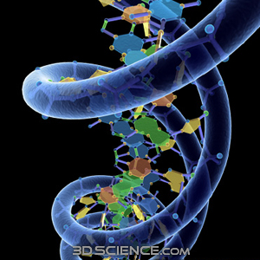
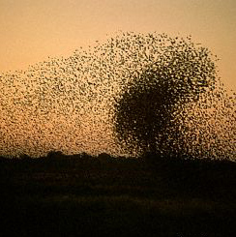
A Problem of Bio-inspired Classification
Used GA, PSO and Hybrid of PSO and GA to optimize fuzzy
(F) The result is equal to or better than a result that was considered an achievement in its field at the time it was first discovered.
  PSO
  GA
In static Analysis we reduced errors to 0%
Our proposed scheme reduced the errors to 2%

Slide 10
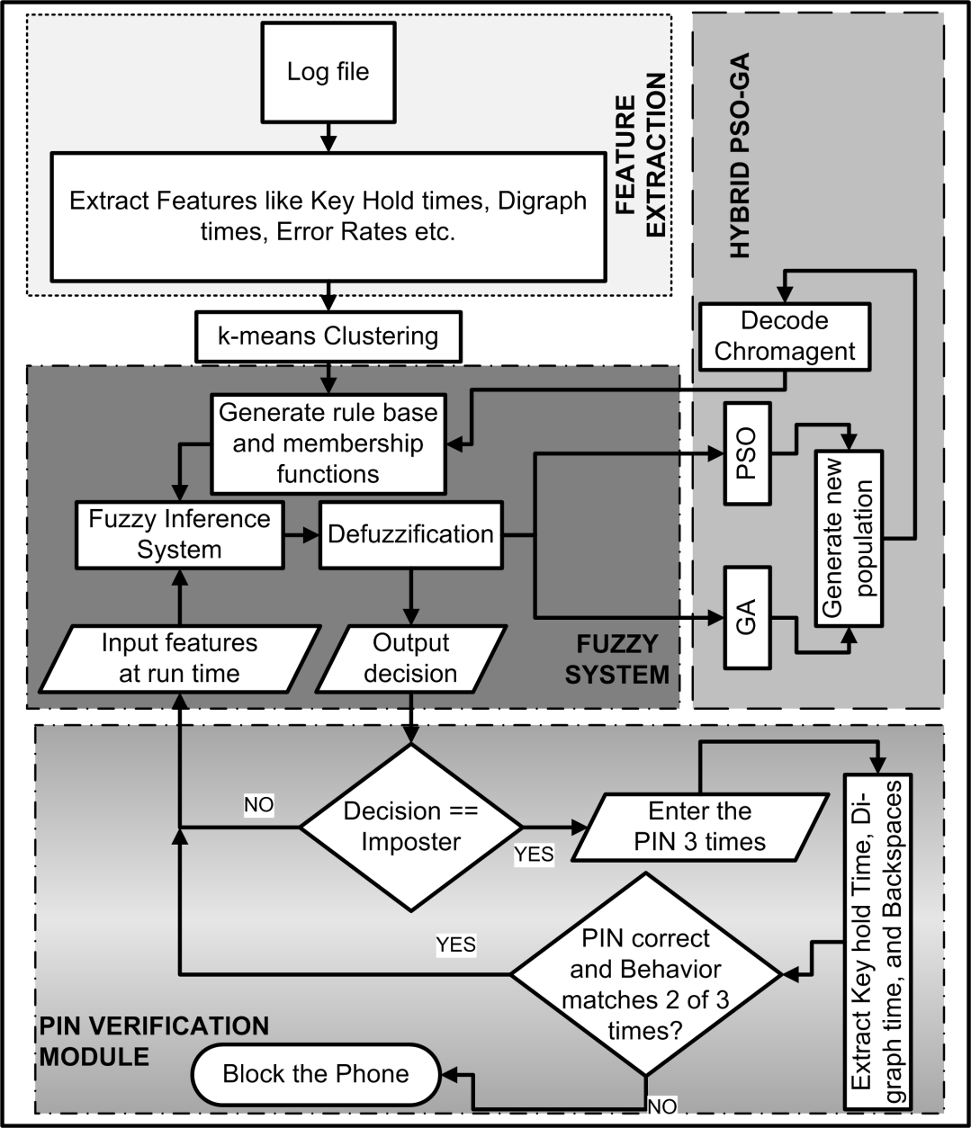
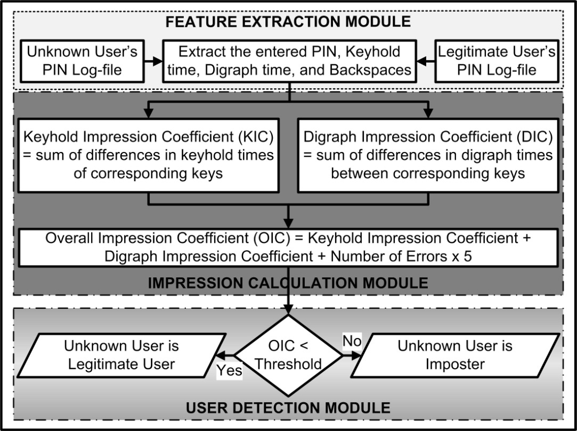
Detection Mode
Verification Mode
Training Mode
Modes
Algorithm for
Verification Mode

Slide 11
Error %ages of classifiers on
Mobile Datasets
(E) The result is equal to or better than the most recent human-created solution to a long-standing problem for which there has been a succession of increasingly better human-created solutions.

Slide 12
The Best Entry
GECCO 2009 – Anonymous Reviewers’ Comments
I like this paper, it is clearly written with a sophisticated command of mechanics and style, it addresses a real world problem using real world data, uses sound methodology, and shows promising results.
In any case, the classifier obtained by optimizing fuzzy rules using a hybrid GA/PSO method is quite interesting and might be worth a separate evaluation as a stand-alone classification tool, independent of the application.
RAID 2009 – Anonymous Reviewers’ Comments
The work is both deep, demonstrating an improvement over approaches that have been used on desktop machines, and broad, considering how to use their approach, and describing limitations of that approach.
I thought that the topic was interesting and relevant, and that the constrained keypad of a mobile phone provides a natural opportunity! for good results.

Slide 13
The Best Entry
We collected keystrokes data of 25 users from diverse backgrounds
It was very hard to convince people because of privacy concerns
This is the first dataset of its kind available freely at http://www.nexginrc.org
Our problem addresses security so lets see how this system is taken in the community of its interest
Paper accepted in RAID 2009: the conference that ranks among the top 5 security conferences in world
Our Problem difficulty is extremely high in its domain, and after over 20 years we have succeeded to make this concept deployable in the real world
The problem is so hot that even RAID 2008 had a research paper on keystroke dynamics though inconclusive
(G) The result solves a problem of indisputable difficulty in its field.

Slide 14
Prototype Version
Prototype Version of the product is ready and you are welcomed to test it at the end of presentation session

Slide 15


