Slide 1
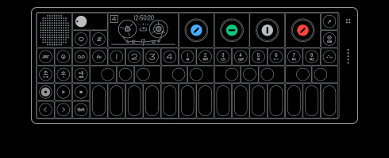



Automatic Synthesizer Preset Generation with PresetGen
Kıvanç Tatar, Matthieu Macret, Philippe Pasquier
ENGAGING THE WORLD

Slide 2
The preset generation problem
Modern synthesizers are very powerful and have many parameters resulting in a vast and complex search space.
The possibilities of a given synthesizer are unknowns and the search space is beyond human grasp.
Preset search is time-consuming and tedious.
  Musicians and sound designers spend time tuning parameters instead of making music.
  The solution found might not be optimal
We want to automate preset generation:
Given a target sound, and a synthesizer, give me a preset for that sound.
Notes:
OP-1 : several synthesis engines
FX
LFO

Slide 3
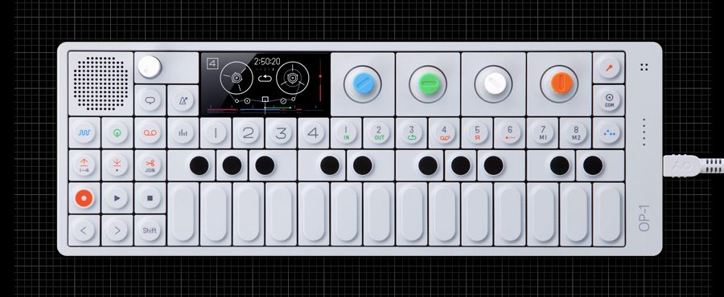
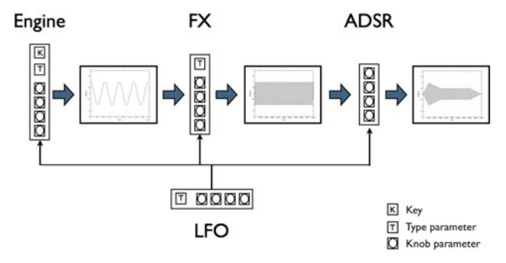


Example synthesizer: the OP-1
The OP-1 is a commercial synthesizer that has a very large presets search space:
  7 synthesis engines
  3 types of LFO (Low frequency oscillators)
  4 types of special effects
  120 keys
The total number of distinct presets is of the order of 10⁷⁶
Added challenges: The space is highly discontinuous and the synthesis engines are non-deterministic (adding warmth to the sound).
Each with 4 parameters with
32767 possible values each
Notes:
Number of particles in the universe is estimated between 10^72 and 10^87 .

Slide 4


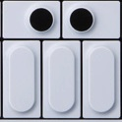

Our solution: PresetGen
We use evolutionary algorithms to locate multiple distinct OP-1 presets to replicate a given target sound
We minimize the 3 objectives distances (Envelope, FFT, STFT) using a multi-objective genetic algorithm: the Non-dominated Sorting Genetic Algorithm-II (NSGA-II)
NSGA-II
...
Target sound
OP-1 presets

Slide 5

1st Objective: Temporal envelope distance
Target sound
Euclidian distance
OP-1 generated
sound

Slide 6
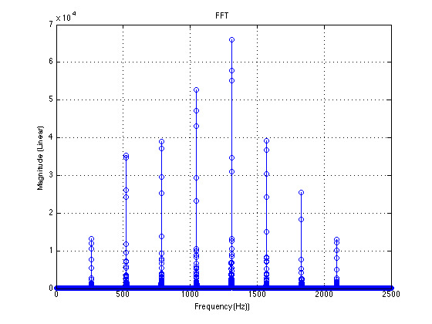
2nd objective: FFT distance for spectral signature
Notes:
Spectral analysis of the sound. Compute on the entire sound

Slide 7
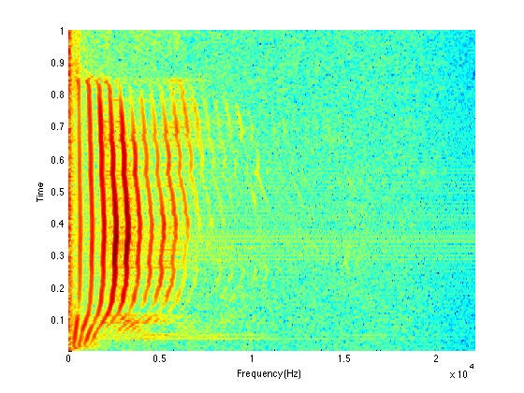
3rd objective: STFT distance for spectral content dynamic
Notes:
FFT on some time frames of the sounds. Each horizontal line in this graph represent the FFT at a given time t.

Slide 8
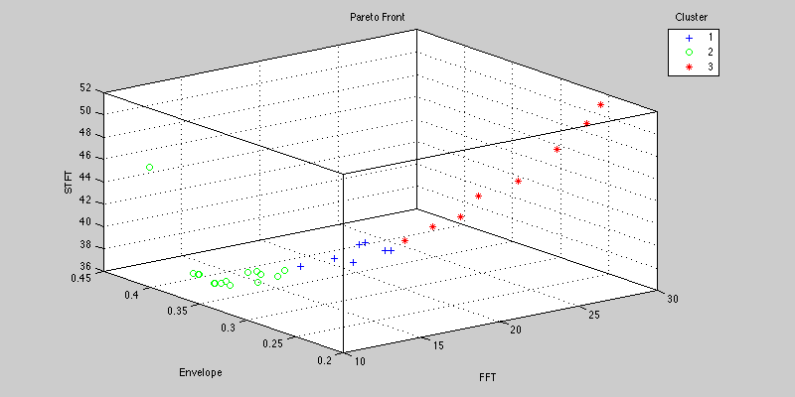
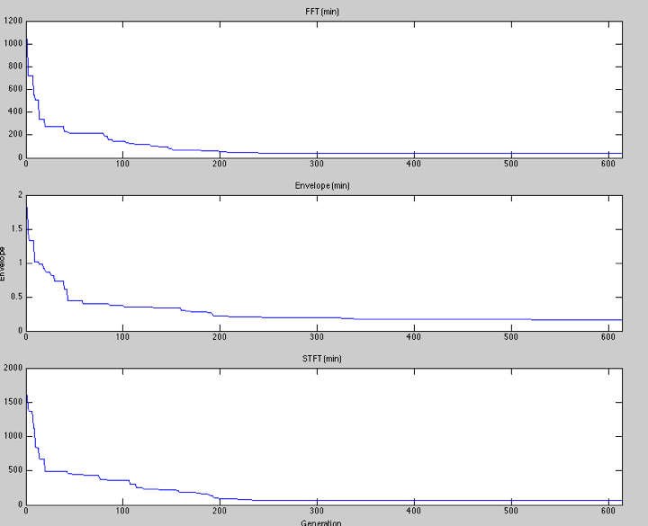
Results
3. We cluster the Pareto front
1. We analyse the target sound
2. We evolve presets
4. We return a variety of presets that approximate the target sound using various synthesis methods!

Slide 9
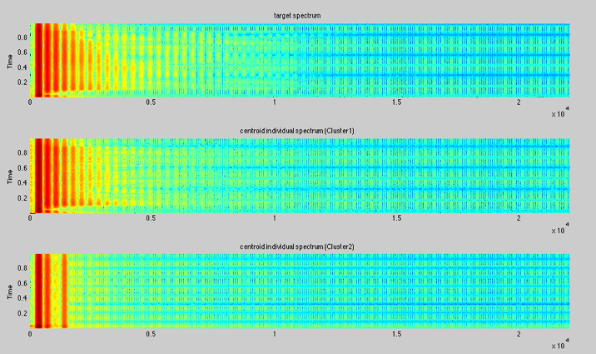

Examples
Target sound
Engine | FX | LFO | Key | Octave
Cluster | Inactive | Inactive | 12 | 0
Engine | FX | LFO | Key | Octave
Cluster | Punch | Inactive | 0 | 1
Engine | FX | LFO | Key | Octave
FM | Grid | Element | 0 | 1

Slide 10
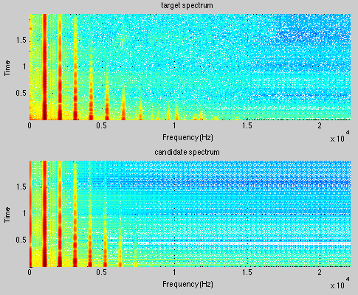

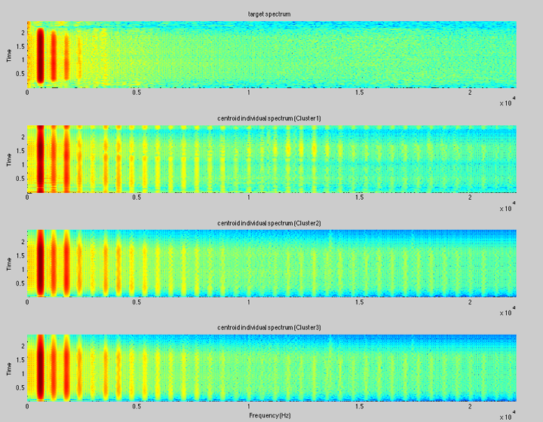
Clarinet
Examples of instruments
Piano
Engine | FX | LFO | Key | Octave
String | Delay | Tremolo | 44 | 1
Engine | FX | LFO | Key | Octave
Digital | Delay | Tremolo | 9 | 1
Notes:
Add number of presets

Slide 11
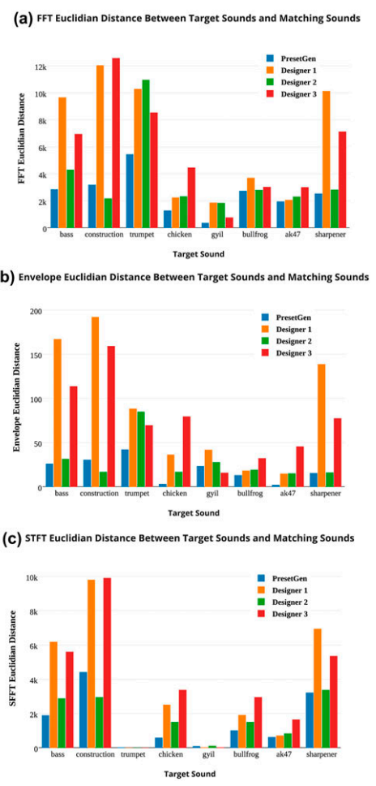
Empirical Evaluation
PresetGen compared to human sound designers.
  8 target sounds:
  3 human sound designer
  14 auditors judge similarity across dimensions.
Results:
  PresetGen sounds rated more similar to target (avg 17%)
  PresetGen outperform humans at the task both in competency and efficiency.

Slide 12




In Conclusion:
PresetGen automates a creative task to human competitive levels and would fit well at a computer-assisted creativity tools in many synthesizers.
DEAP
Notes:
NSERC logo
Teenage engineering logo
Westgrid logo
DEAP logo

